Slide 1

RESIDENT ENGINEERS
ACADEMY
Instructors:
Blas Martinez Jr.
Seree 'Mack' Yenjai
Notes:
Trainer Notes:
Welcome class and let them know how excited we are to have them. It’s going to be a full 4 days of training, so get comfortable get your cup of coffee and more importantly be willing to participate and be engaged in this virtual platform. Go over the communication features and protocol, i.e. mute yourself when not speaking.

Slide 2
Instructors
Blas Martinez Jr.
Seree 'Mack' Yenjai​
Mack is a Construction Oversight Engineer for Headquarters Local Assistance serving local agencies from Ventura County (District 7) to Los Angeles County (District 7). He has worked for Caltrans for more than 13 years in various capacities: as an Acting Branch Chief in HQ METS, as an Independent Assurance Lead Engineer, and as a bridge design engineer. Prior to that, he worked for the City of Los Angeles for 2 years as Structural Engineering Associate. Before the City of LA, he worked for a geotechnical and structural firm since 1999. He graduated from Cal Poly Pomona with a degree in engineering and is a licensed Professional Engineer.
Blas is a Construction Oversight Engineer for Headquarters Local Assistance serving local agencies in Districts 6 and 10.
He has worked for Caltrans for more than 15 years as a Project Engineer, Cost Estimator and Resident Engineer.
Prior to that, he worked for Tulare County as a design engineer. He graduated from Cal Poly San Luis Obispo with a degree in civil engineering and is a licensed Professional Engineer.

Slide 3
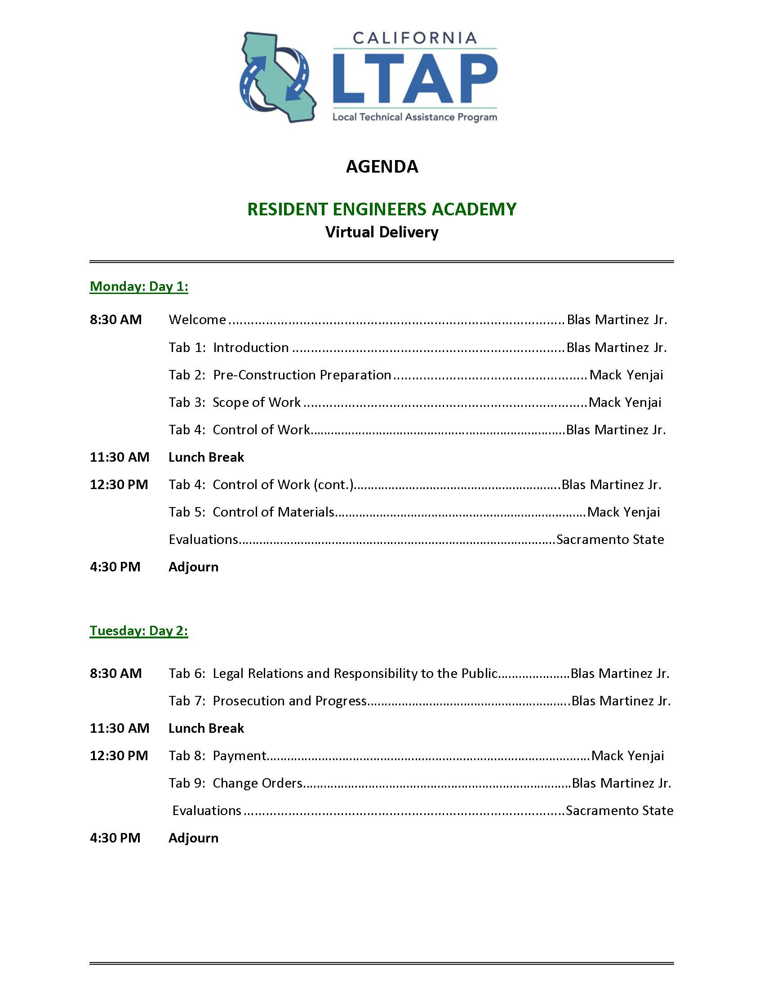
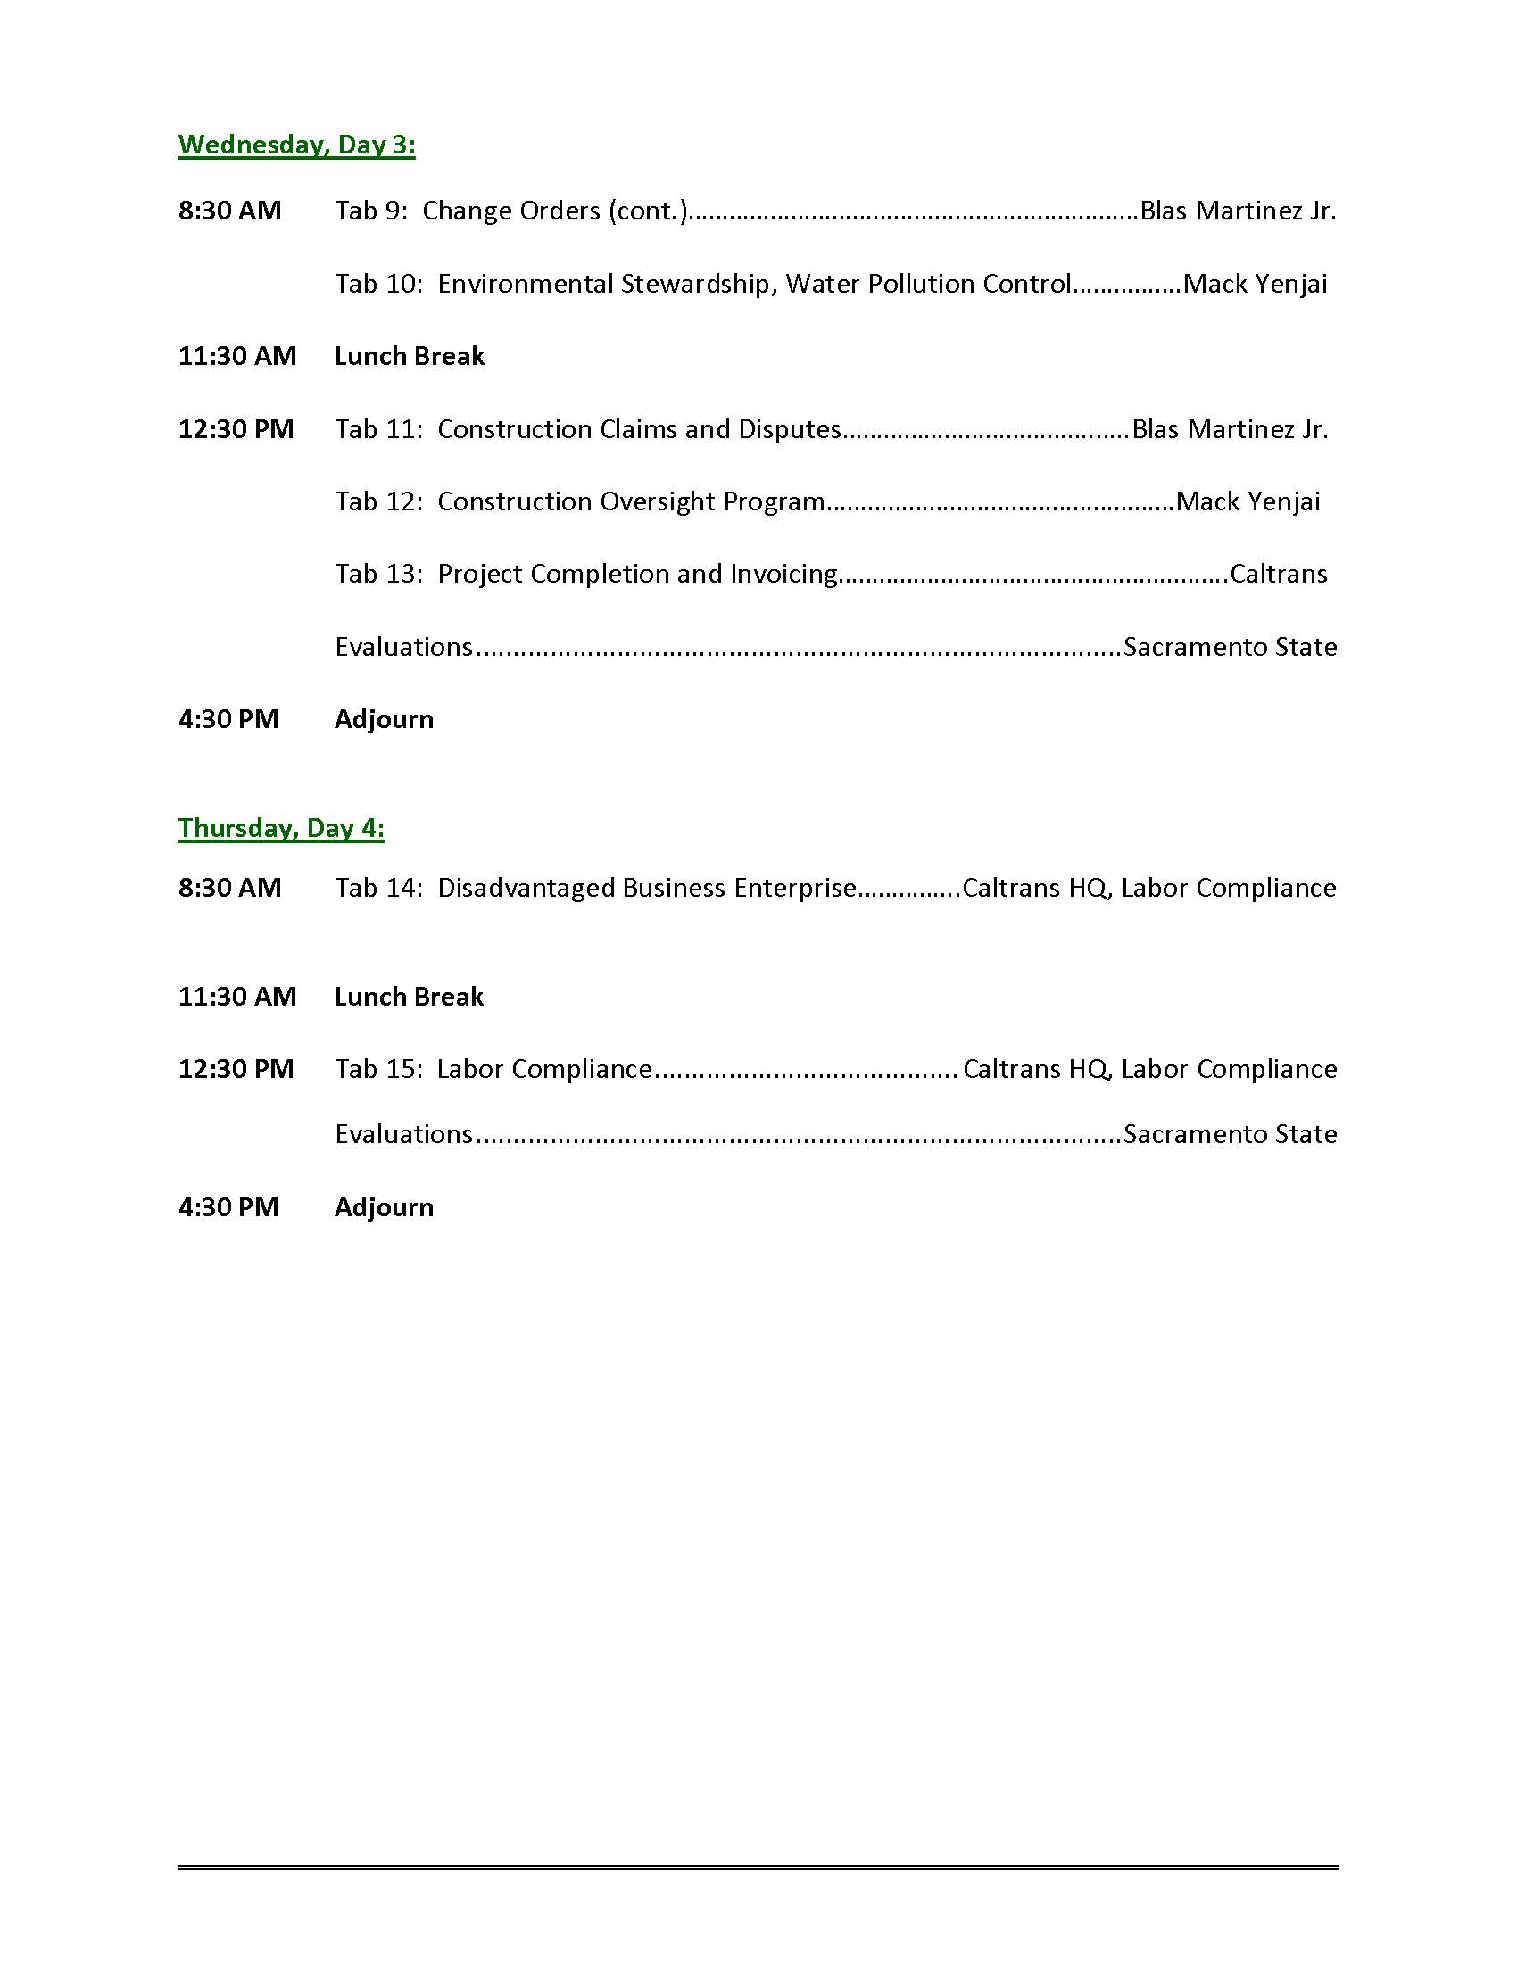
Agenda
Notes:
Trainer Notes:
Breaks will be provided at various times.

Slide 4
Objectives
Prepare you to be a RE on a federal-aid construction project.
Make you aware of Federal and State requirements.
Teach you to administer and document the process.
Prevent your agency from losing federal funds.
Notes:
Trainer Notes:
Keep you out of trouble with State and Federal auditors.

Slide 5

Introductions
Name
Employer (agency or firm)
Position (RE, Inspector, PM, CM, etc.)
Years of construction experience
State your expectations for this course –
be specific
Notes:
Trainer Notes:
Go around the room and ask people to provide the information on the slide.

Slide 6
Topics Covered in the
Resident Engineers Academy
Pre-Construction Preparation
Scope of Work
Legal Relations and Responsibility to the Public
Payment
Control of Work
Prosecution and Progress
Change Orders
Control of Materials
Water Pollution Control
Project Completion and Invoicing
Construction Claims and Disputes
Labor Compliance
Construction Oversight Program
Environmental Stewardship
Notes:
Trainer Notes:
Don’t need to spend a lot of time here, they can see most of these on the agenda.

Slide 7
Types of Resident Engineers
The Resident Engineer who. . .
        Makes Things Happen!
        Watches Things Happen!
        Wonders What Happened!
Notes:
Trainer Notes:
Proactive RE
Hesitant RE
Disengaged/uninformed RE

Slide 8
Remember . . .
Contract
Contractor
Traffic Conditions
Job Site
Materials
Equipment
Construction Methods
The only constant is CHANGE
Notes:
Trainer Notes:
Remind students not to assume that:
your current specifications are the same as your last job.
you have been around so long you know everything by memory and don’t need to look at the plans or specs.
the old timer who taught you was doing it correctly.
Look at each project as new, and read each contract as new.
Each contract is different.

Slide 9
Resident Engineer
Equilateral Triangle
Quality
Time
Budget
Notes:
Trainer Notes:
You are striving to get:
A Quality Project
On Time
On Budget
Some will say you usually only get two.

Slide 10
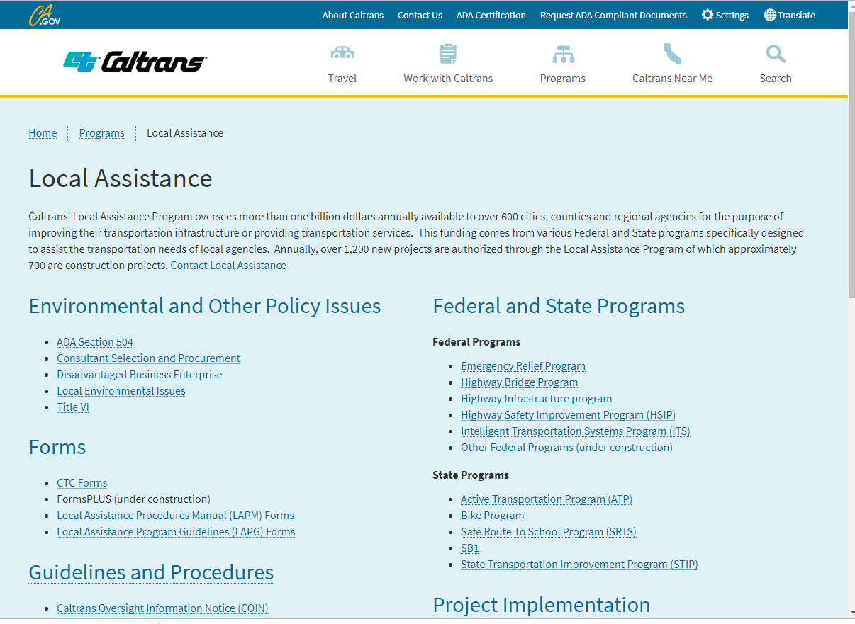
Link of Local Assistance
https://dot.ca.gov/programs/local-assistance
Notes:
Trainer Notes:
Link to important info for LPAs

Slide 11
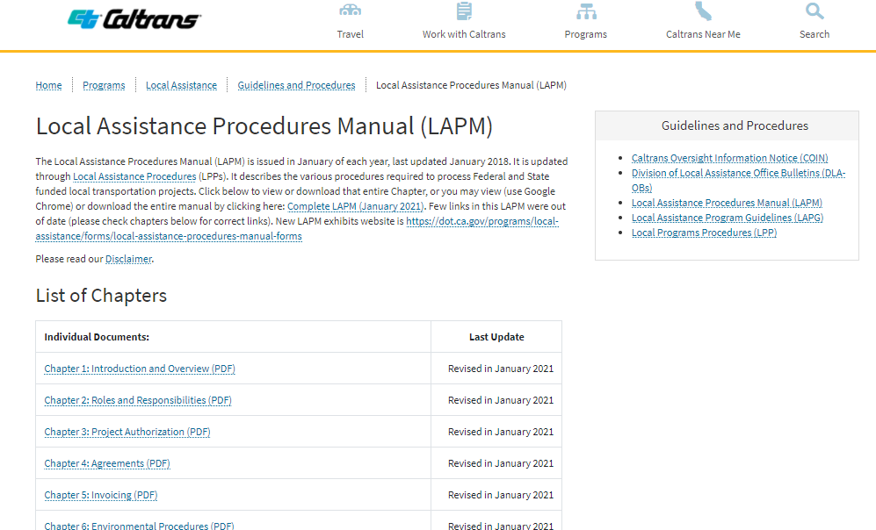
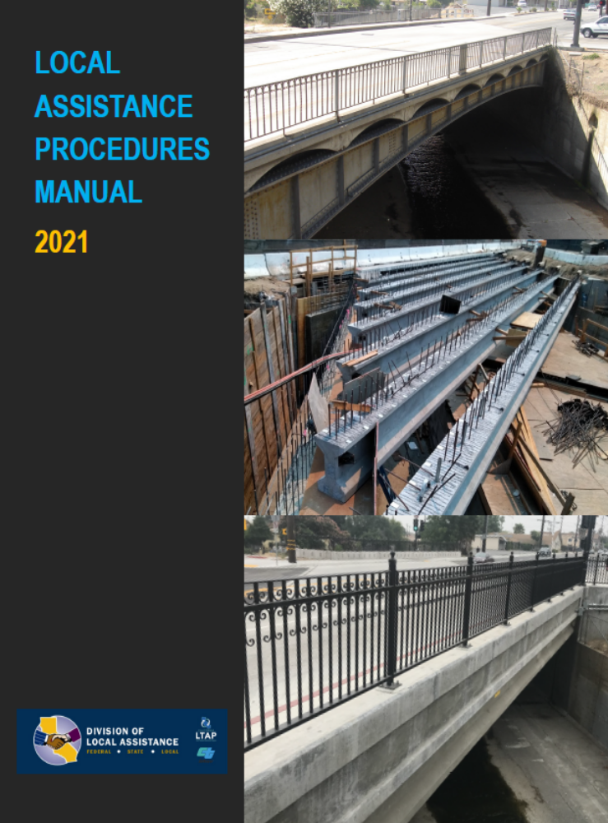
LAPM
https://dot.ca.gov/programs/local-assistance/guidelines-and-procedures/local-assistance-procedures-manual-lapm
Notes:
Trainer Notes:
The LAPM provides the essential information for LPAs for their federal aid projects.

Slide 12
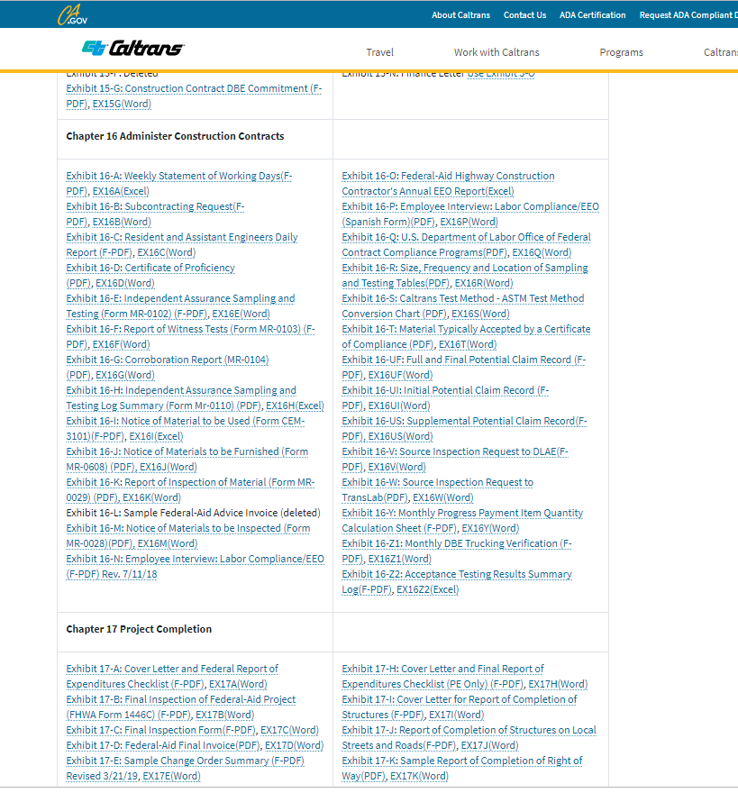
LAPM forms
https://dot.ca.gov/programs/local-assistance/forms/local-assistance-procedures-manual-forms
Notes:
Trainer Notes:
Chapter 16 is where you will find many of the forms you need for the construction process. Some you must use, others are just samples and the agency can make their own version.
Examples that you must use:
16-B, Subcontracting Request
16-Z, Monthly DBE Tracking Verification
16-N, Employee Interview Labor Compliance
Examples of form that are samples/guidelines:
16-A WSWD
16-C Daily Report

Slide 13
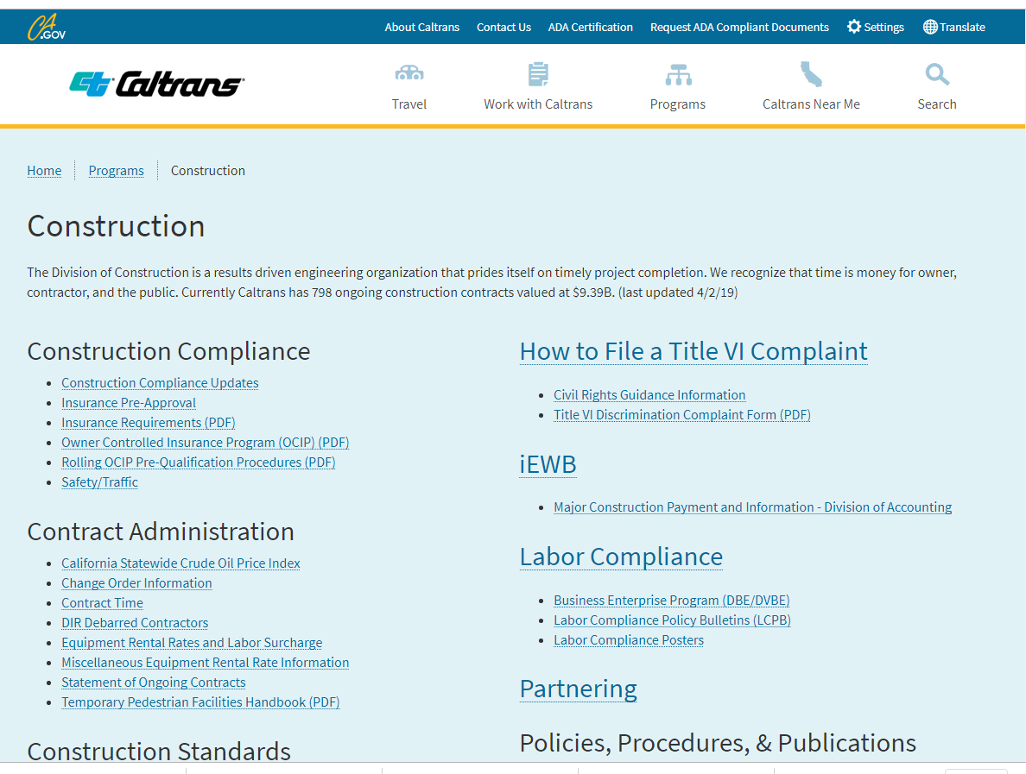
Construction
https://dot.ca.gov/programs/construction
Notes:
Trainer Notes:
CT Division of Construction website has useful information as well.

Slide 14
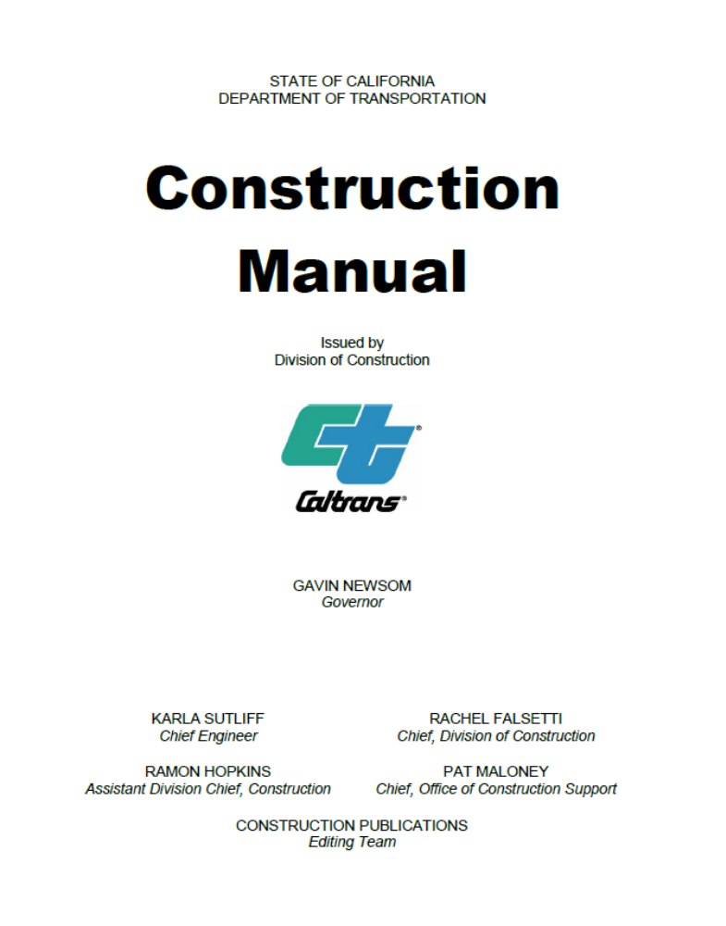
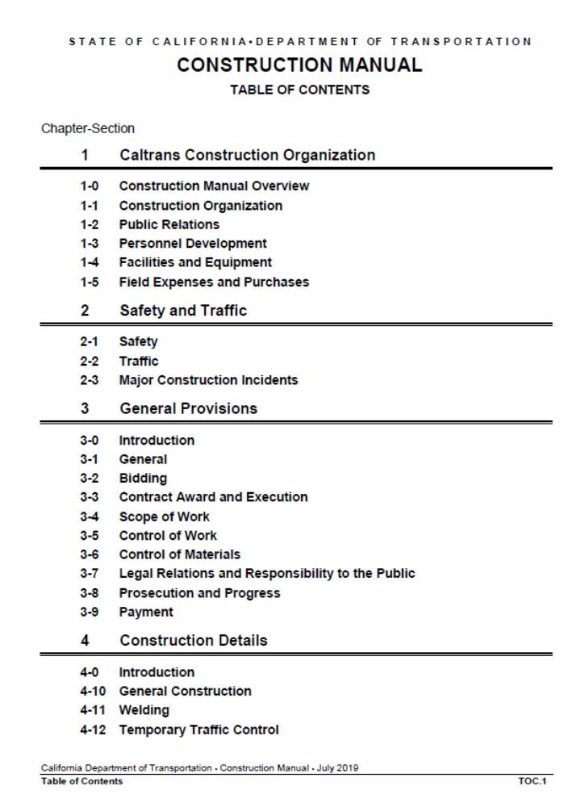
Construction Manual
http://www.dot.ca.gov/hq/construc/constmanual/construction_manual.pdf
Notes:
Trainer Notes:
Those areas marked in green are key one’s the REs will find useful.
Chapter 4: Construction Details is great for REs and especially field inspectors.
(go to next slide)

Slide 15
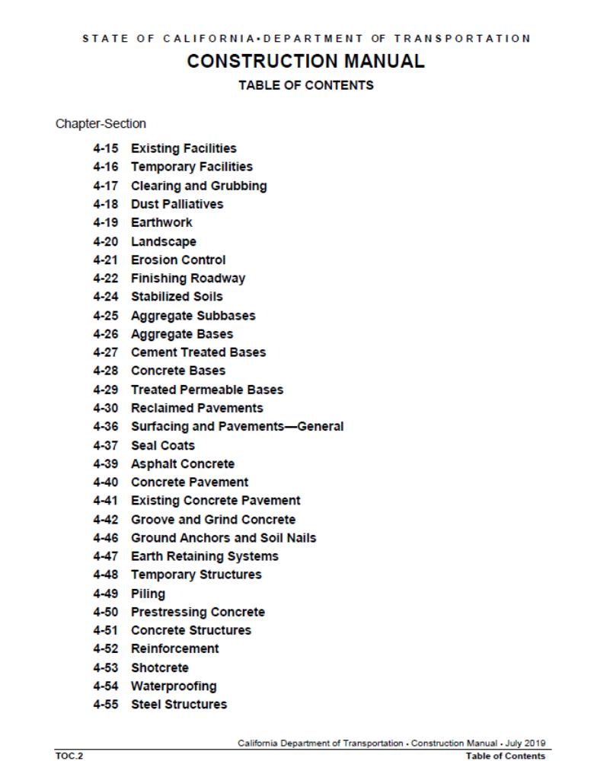
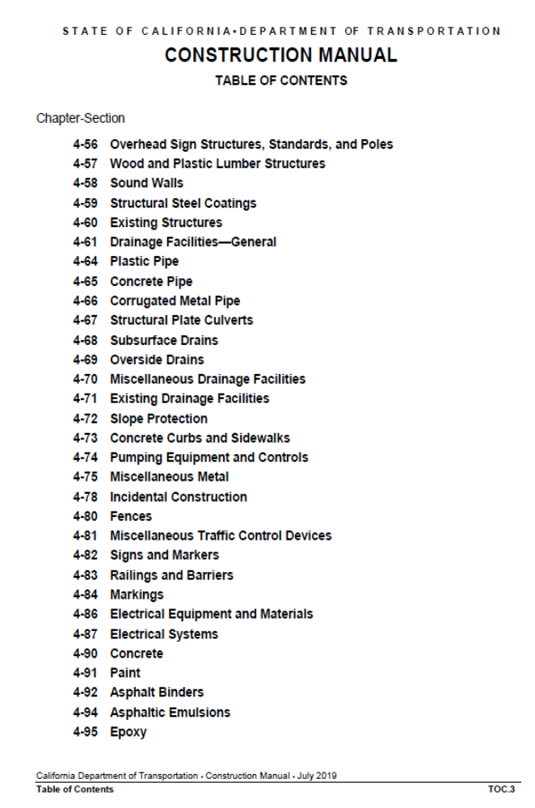
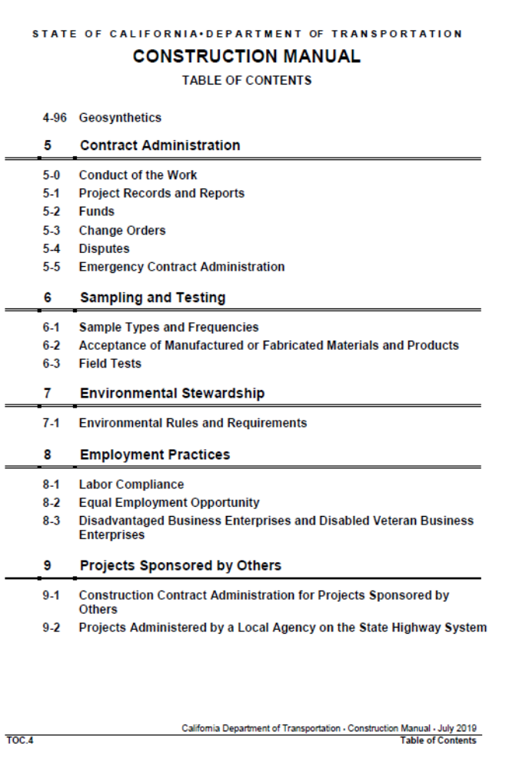
TOC of Construction Manual
http://www.dot.ca.gov/hq/construc/constmanual/construction_manual.pdf
Notes:
Trainer Notes:
Let students know that they can use this part of the manual to find information on how to inspect just about any work; Aggregate Bases, Pre-stressing Concrete; Markers and Delineators
What to do before the operation begins
What to do during the operation
What to do after

Slide 16
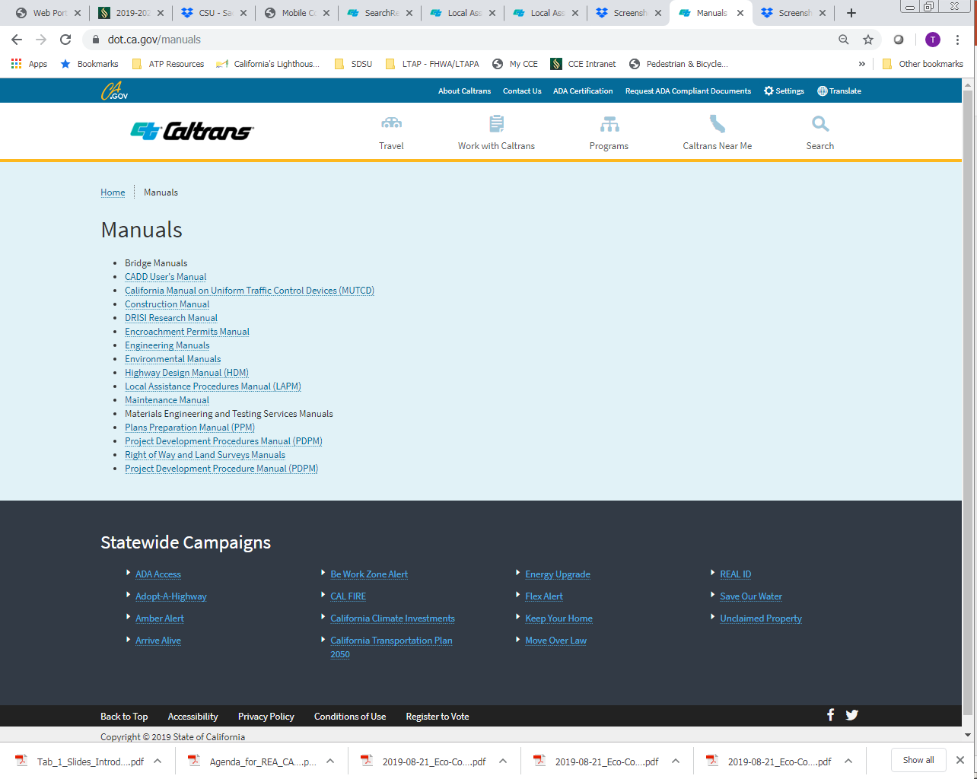
Manuals
https://dot.ca.gov/manuals
Notes:
Trainer Notes:
Another resource for various CT manuals.

Slide 17
Definitions of Key Terms
Local Agency – A city, county or other public agency
Administering Agency – Local agency that advertises, awards and administers the contract
Construction Engineering (CE) – Contract administration from advertisement through ribbon cutting and close out
Notes:
Trainer Notes:
Chapter 1 of the LAPM has many definitions of key terms.
Example of “other” public agency; VTA – Santa Clara Valley Transportation Authority, School Districts.
Advertise, Award, Administer (Triple “A”) – always go together. If your agency wants to advertise and award, they need to do the construction administration.
Federal-aid: There are other funds beside FHWA, but for this class, we are talking about FHWA.
LAPM Chapter 1 has more Terms and Definitions – can be handy if you need clarification.

Slide 18
Definitions of Key Terms
FHWA – Federal Highway Administration
Federal-aid – FHWA funds
List of Acronyms (Handout Pgs. 1-16)
Notes:
Trainer Notes:
Other fed money, FTA funds.
FTA: Federal Transportation Authority

Slide 19
Authority: Why you must follow the procedures taught this week
FHWA
Caltrans
= Joint Stewardship and Oversight Agreement
“E” Exempt from FHWA Oversight (aka delegated)
“N” Not Exempt
Local Agency
Caltrans
= Master Agreement
Plus “Supplemental Agreements” for individual projects
LAPM Section 4.2 Agreements
Notes:
Trainer Notes:
Green boxes: agency to agency agreements regarding spending transportation money
Bullets: per project refinement of the agreements.
Explain the relationship between FHWA and CT, then CT and Local Agency
FHWA and Caltrans: (Chap 2 LAPM)
US Code allows the US DOT and State DOTs to enter into an agreement defining the extent to which the State assumes the project approval and oversight responsibilities of the USDOT (Think of it as FHWA subcontracting out program management and and project delivery of the Federal-aid Highway Program.)
The agreement = FHWA/Caltrans Joint Stewardship and Oversight Agreement (aka Stewardship Agreement)
Through the Stewardship Agreement, FHWA has delegated responsibility for oversight and approval of low risk project level activities to Caltrans. (Delegated Project = “E” for exempt from FHWA oversight)
High Risk (High Profile) projects are not delegated (= “N” for Not Exempt)
“E” and “N” appear in the federal project number.
For Delegated projects, Caltrans has authority for all aspects of a Federal-aid project except those activities which may not be delegated by federal law (requiring FHWA approval).
Delegated projects include projects that are routine and inherently low risk in which Caltrans has a high level of experience and well documented procedures and processes in place for ensuring compliance with federal requirements.
Over 99% of Local Assistance Projects are delegated in which Caltrans or the local agency has approval authority for most project level activities.
FHWA maintains many project level approval activities for High Profile projects.
Examples of High Profile Projects: experimental; > $500M; Unusual Structures; Pilot Projects.
Caltrans is responsible and accountable to the FHWA for administering the successful implementation of federal-aid programs and projects in accordance with laws, regulations, and policies that govern the federal-aid program.
Caltrans establishes uniform policies and procedures to assist the local agencies in meeting the program requirements for their projects.
Caltrans and Local Agency (Chap 4 LAPM)
Local Agency-State Master Agreement (aka Master Agreement) - An agreement between the local public agency and the State defining the general terms and conditions which must be met to receive federal-aid or state funds for the following programs:
Federal-aid Highway Program
State-only Funded Projects
In the Master Agreement, a local agency agrees to comply with all federal and state laws, regulations, policies and procedures relative to the design, right of way acquisition, environmental compliance, construction and maintenance of the completed facility.
Program Supplement Agreement - A Local Agency-State Agreement, which amends (supplements) the Master Agreement to describe the phases, costs and special conditions, that apply to a specific project.
Conclusion: REs - this is why you are obligated to follow the procedures in the LAPM and those we will discuss this week.

