Slide 1
Environmental Stewardship and
Water Pollution Control
Notes:
Trainer Notes:
What is environmental stewardship:
Protection of environmental resources.
Examples of Env. Resources:
Archeological: Historic Bridges, Indian Burial Grounds
Biological: Endangered species, Migratory Bird
Physical: Surface Mining and Reclamation Act (SMARA)
Air/Water/Noise
Proper Handling of Hazardous Waste

Slide 2
Environmental
Stewardship
Notes:
Trainer Notes:
Environmental Stewardship encompasses the protection of both human and natural resources and quality of life. It considers the affects of a single project and/or the cumulative affect of multiple projects on…
planned growth or land use for the area,
the relocation of significant numbers of people;
natural, cultural, recreational, historic resources;
air, noise, or water quality
travel patterns
significant environmental impacts (individually or cumulatively)

Slide 3
Environmental Stewardship:
Objectives
Be able to...
Name the laws that mandate protecting the environment
List the duties an RE must perform to comply with these laws
Document compliance
Notes:
Trainer Notes:
Have them read bullets to themselves

Slide 4
Environmental Stewardship:
Federal Law
National Environmental Policy Act
(NEPA) of 1969
  …to prevent or eliminate damage to the environment and biosphere and stimulate the health and welfare of man,…
Notes:
Trainer Notes:
NEPA - United States Environmental Law.
Purpose - ensure that environmental factors are weighted equally when compared to other factors in the decision-making process.
NEPA requirements apply to all federal agencies. (e.g. FHWA)
A project is required to meet NEPA guidelines when a federal agency provides any portion of financing or review for the project.

Slide 5
Environmental Stewardship:
Federal Law
  The Relationship between FHWA and NEPA
Congress
National Environmental Policy Act
FHWA
Title 23, Code of Federal Regulations (23 CFR)
23 CFR
Part 771, Environmental Impact and Related Procedures
Notes:
Trainer Notes:
Purpose of this slide is to lead students to an how we go from NEPA to what they must do on their projects. environmental
An “Act” is implemented is through regulations established by the federal agency involved.
The federal agency we care about is the Federal Highway Administration (FHWA)
Regulations may as well be laws because you must comply with them under penalty of law.
All those rules and regulations created by federal agencies are found in The Code of Federal Regulations (CFR)
And all rules and regulations created specifically by FHWA can be found in Title 23 of the CFR (a title is like a Chapter).
Other titles contain the rules and regulations created by other Federal agencies, for example, Title 26 contains rules and regulations created by the Internal Revenue (aka the IRS)
Part 771 of Title 23/Chapter 23 is “Environmental Impact and Related Procedures”
These are the procedures set up by FHWA for Highway related projects to comply with NEPA .
FHWA Federal aid projects must comply with the laws of 23 CFR 771.

Slide 6
Environmental Stewardship:
Federal Law
NEPA Mandated Federal Agencies to:
Consider potential environmental consequences of proposed project
Document the analysis of those consequences
Allow for public for comment prior to implementation
Notes:
Trainer Notes:
ASK CLASS: How is this mandate fulfilled?
Answer: By each project having an environmental document.
The environmental document is the finalized assessment/determination process which fulfills this mandate.

Slide 7
Environmental Stewardship:
Federal Law
National Environmental Policy Act (NEPA)
The 3 Types of Project
Environmental Documents
Categorical Exclusion (CE)
=>
No Determination Needed
Environmental Assessment (EA)
=>
FONSI
or
further study
Environmental Impact Statement (EIS)
=>
Record of Decision (ROD)
Notes:
Trainer Notes:
The environmental document for your projects will be in one of these 3 forms.
As we moved from left to right, the document becomes more involved (the project likely has more impact on the environment.)
90 %Categorical Exclusion (no affect): The simplest. A Categorical Exclusion (CE) means your type of project falls into a pre-established category that based on past experience with similar projects, does not involve significant environmental impacts... , therefore, neither an EA nor an EIS is required. Most common for local agency projects. You see this on overlays, city street drainage installations, traffic calming jobs, etc …
If you have a CE on your project, check the page numbers. If page 1 says 1 of 2, be sure you have page 2.
If you project does not qualify for Categorical Exclusion, then an Environmental Assessment (EA) is performed. Based on the EA, a determination is made of either Finding No Significant Impact (FONSI), or that an impact will occur and further study is needed. If further study is needed – see 3.
Environmental Impact Statement is a more involved study of the impacts. Once complete, a determination is made, the Record of Determination (ROD)
A local agency cannot proceed with Final Design until Caltrans has approved the environmental document.
Have one of these 3 documents in your project files.
Read it.
Be sure your PS&E complies with it (Design should have taken care of this, but sometimes things get missed.)
Be able to produce it for an auditor or reviewer when they ask to see your “environmental document.”
Extra info for instructor:
1. The EA is intended to be a concise document that provides sufficient evidence and analysis for determining whether to prepare an EIS. If no substantial effects on the environment are found after investigation and drafting of an EA, the agency must produce a FONSI. A FONSI presents the reasons why an action will not have a significant effect on the human environment.
2. If it is determined that a proposed federal action does not fall within a CE or does not qualify for a FONSI, then the responsible agency or agencies must prepare an EIS. The purpose of an EIS is to help public officials make informed decisions that are reflections of environmental consequences and the alternatives available. The ROD follows the EIS. The ROD summarizes any mitigation measures that will be incorporated into the project.
3. If someone asks what is an EIR (environmental impact report), that is the State version of an EIS. NEPA=EIS, CEPA=EIR
CEPA = California Environmental Policy Act.

Slide 8
Environmental Stewardship:
Federal Law
Environ. Doc.
Clean Air Act
Clean Water Act
Endangered Species Act
Migratory Bird Act
Marine Mammal Act
Native American Grave Act
Wetlands Resources Act
Farmland Protection Act
National Historic Preserv. Act
Flood Disaster Protection Act
Notes:
Trainer Notes:
Here are some, not all, of the many other Federal Acts that must be considered when preparing the environmental document.
An ACT is a law passed by Congress.
Note to Instructor: No need to spend time on this other than to show the students that there are a bunch of laws that must be considered.

Slide 9
Environmental Stewardship:
Federal Law
It shall be the responsibility of the…agency to ensure that the project is constructed in accordance with and incorporates all committed environmental impact mitigation measures listed in approved environmental documents…
23 CFR 771.109(d)
Notes:
Trainer Notes:
This regulation (shown in the slide) is the key regulation that an agency and RE needs to understand
REs:
Get a copy of the environmental document for your project
Read it.
Be sure all environmental commitments made it into your project plans and specifications
If something was missed write a CCO
Be sure a copy of the environmental documents is in your project files.

Slide 10
Environmental Stewardship:
Local Assistance Procedures Manual
LAPM
Chapter 6 Environmental Procedures
      6.1 Roles and Responsibilities
      6.3 Mitigation and Construction
Notes:
Trainer Notes:
Note to instructor: making transition from federal laws to what Caltrans Local Assistance requires of agencies .
To get federal funding you agency had to sign a Master Agreement with Caltrans in which they agreed to comply with all federal and state laws, regulations, policies and procedures .
For project OFF the State highway system, the procedures your agency agreed to comply with are those in the LAPM.
Q: If your project is ON the State Highway System what procedures must you follow?
A: Those in the Caltrans Construction Manual.
This slides shows the parts of the LAPM that pertain to environmental requirements and construction

Slide 11
Environmental Stewardship:
Local Assistance Procedures Manual
The local agency will obtain all necessary permits prior to advertisement for construction.
  LAPM 6.2 An Overview of the Environmental Process;
  Other Considerations Permits
Notes:
Trainer Notes:
Per LAPM, the agency must get any permits.
Environmental impact mitigation measures can be found in the project permits and environmental document.
Have a copy of all permits for your project.
Check that expiration dates
Contact your PM and the agency Person in Responsible Charge if you have a problem.
Some Examples of Permits commonly seen:
Encroachment Permits
Clean Water Act Section 404 Permit
Fish and Game Permit Section 1601 Lake and Streambed Alteration Permit
Coast Guard Bridge Permit

Slide 12
Environmental Stewardship:
Local Assistance Procedures Manual
The local agency is responsible for ensuring that mitigation commitments are…
Incorporated into the PS&E
Implemented during construction
Documented!
Maintained as required
LAPM 6.1 Roles and Responsibilities, Local Agency
Notes:
Trainer Notes:
The LAPM says….
With the possibility of so many permits, how does an RE keep track of all the environmental mitigation commitments?!

Slide 13
Environmental Stewardship:
Local Assistance Procedures Manual
The local agency must certify that all required mitigation is included in the PS&E.
LAPM 6.3 Mitigation and PS&E
The local agency must document and certify that all environmental commitments have been completed.
LAPM 6.3 Mitigation and Construction
Notes:
Trainer Notes:
This must be done before an agency can get its E76 (authorization of federal money).

Slide 14
Environmental Stewardship:
Local Assistance Procedures Manual
Environmental Commitment Record (ECR):
  Record each environmental commitment made (PS&E)
  Specify how each commitment will be met (PS&E)
  Document the completion of each commitment (Constr.)
Notes:
Trainer Notes:
How the agency certifies that all environmental commitments have been completed and that documentation to this effect has been prepared for inclusion in the projects’ final record/voucher:
LAPM requires agencies to create an Environmental Commitment Record (ECR) for each project.
ECR is a list complied by the local agency of all the mitigation commitments required to comply with NEPA .
If a project has multiple permits (Fish and Game, Marine Fisheries, etc…) it puts all the mitigation commitments listed in those permits into one place
Goal of the ECR is to track and document the completion of the environmental commitments throughout the Project Delivery process.
ECR stays with the project records.
A completed ECR gets included with the final record/voucher.

Slide 15
Environmental Stewardship:
RE Responsibilities Pre-Construction
Verify the environmental doc and permits all in the project file
Confirm all mitigation measures shown on the environmental docs and permits made it into your contract (PS&E)
Document as mitigation measures are completed
Notes:
Trainer Notes:
Instructor: Transitioning into roles and responsibilities of the RE
ECR: Environmental commitment record
Be sure your copy of the environmental document includes copies of the Biological Opinion (BO), Memorandum of Agreement (MOA), and any permits, if applicable.
Read your environmental document and permits - check your the ECR to be sure nothing was missed.
If any mitigation measures were omitted from the PS&E, write a CCO to add them. Get your PM and Person in Responsible charge on board.

Slide 16
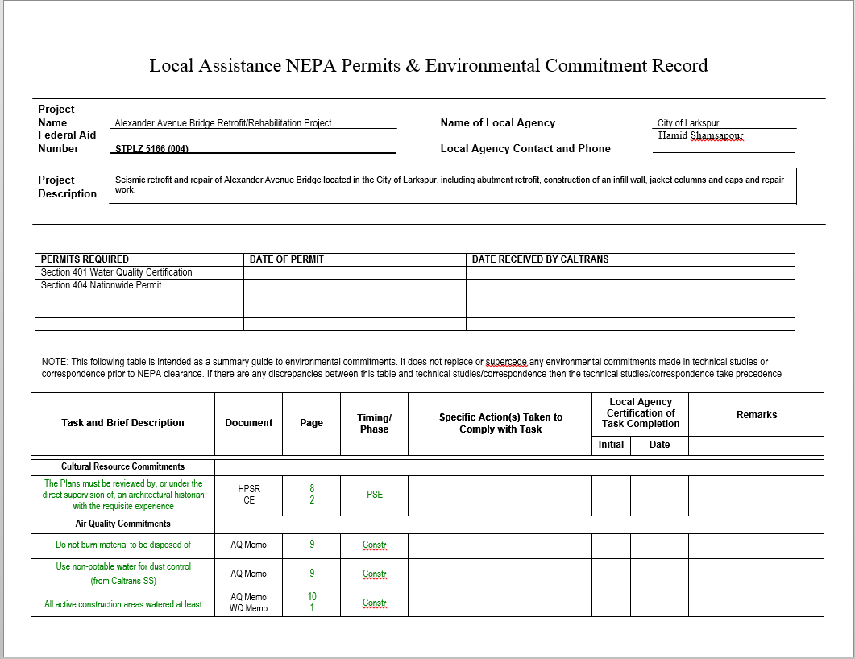
Environmental Stewardship:
Local Assistance Procedures Manual
Notes:
Trainer Notes:
Sample form from one agency.
How the agency certifies that all environmental commitments have been completed and that documentation to this effect has been prepared for inclusion in the projects’ final record/voucher:
LAPM requires agencies to create an Environmental Commitment Record (ECR) for each project.
ECR is a list complied by the local agency of all the mitigation commitments required to comply with NEPA .
If a project has multiple permits (Fish and Game, Marine Fisheries, etc…) it puts all the mitigation commitments listed in those permits into one place
Goal of the ECR is to track and document the completion of the environmental commitments throughout the Project Delivery process.
ECR stays with the project records.
A completed ECR gets included with the final record/voucher.

Slide 17
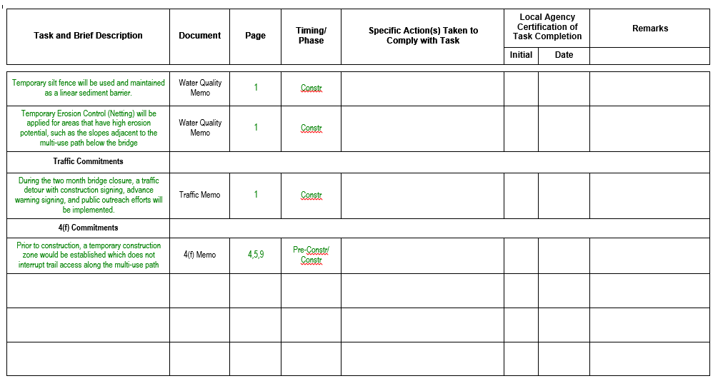
Environmental Stewardship:
Local Assistance Procedures Manual
Sample ECR page 2
Notes:
Trainer Notes:
How the agency certifies that all environmental commitments have been completed and that documentation to this effect has been prepared for inclusion in the projects’ final record/voucher:
LAPM requires agencies to create an Environmental Commitment Record (ECR) for each project.
ECR is a list complied by the local agency of all the mitigation commitments required to comply with NEPA .
If a project has multiple permits (Fish and Game, Marine Fisheries, etc…) it puts all the mitigation commitments listed in those permits into one place
Goal of the ECR is to track and document the completion of the environmental commitments throughout the Project Delivery process.
ECR stays with the project records.
A completed ECR gets included with the final record/voucher.

Slide 18
Environmental Stewardship:
RE Responsibilities Pre-Construction
If required by your environmental docs or permits …
Confirm Inspector/construction crew trainings held
Verify ESA staging areas are fenced
Approve biological monitors
Notes:
Trainer Notes:
The ECR might be require these prior to start of project or prior to specific operations
Examples of crew training that may be mandated:
Handling of hazardous waste
Relocation of endangered species
ESA = Environmentally Sensitive Area (not Equipment Storage Areas)
Examples of Biological Monitors:
Monitoring steelhead during construction of footings for a bridge.
Checking dens and relocating red legged salamanders prior to clear and grub

Slide 19
Environmental Stewardship:
RE Responsibilities Pre-Construction
If required by your environmental docs or permits …
Perform preconstruction surveys
Relocate plants
Take photographs
Complete reports
Notes:
Trainer Notes:
Examples of Preconstruction Surveys:
Archeological
Biological
Nesting birds
Migratory Fish
Examples of photographs that might be required as mitigation:
historic buildings
Historic bridges

Slide 20
Environmental Stewardship:
RE Responsibilities Mid-Construction
If required by your environmental docs or permits …
Confirm operations comply with permit dates
Confirm contractor adhering to daily time restrictions
Notes:
Trainer Notes:
What are significant dates you might see on permits:
Nesting Bird Season
Working in a streambed
At the start of a project, check your permit dates to be sure they have not expired already or that they will expire before the related work is completed.
How might daily time restrictions relate to environmental concerns?
Air pollution : traffic is delayed during peak commute hours causing huge backups.
Noise pollution : Pile driving at night
Disruption of endangered species – movement, breeding?

Slide 21
Environmental Stewardship:
RE Responsibilities Mid-Construction
If required by your environmental docs or permits …
Verify archeological or biological monitors are present
Verify biological surveys are continuing as required throughout operations
Notes:
Trainer Notes:
ASK Class for examples of operations that required archeological or biological monitors.
Example: a project where a biologist had to be on site at all times when the contractor performed earthwork adjacent to a pond containing red legged frogs. The biologist had to personally relocate to safety any frogs found.
ASK Class what kind of biological surveys have been required on their projects during operations.
Example: Most common, biologist survey for nesting birds prior to tree removal.
Example: Biologist surveying burrows for spotted salamanders prior to clear and grub work.

Slide 22
Environmental Stewardship:
RE Responsibilities Mid-Construction
If required by your environmental docs
or permits, verify...
Approved hauling routes are used
Borrow and disposal site requirements are followed
Notes:
Trainer Notes:
Ask Class: In what document might hauling routes have been approved?
ANSWER: SWPPP (Storm Water Pollution Prevention Plan)
Ask Class: If a contractor wants to change the hauling routes, what do they need to do?
ANSWER: Submit an amendment to the SWPPP for approval.

Slide 23
Environmental Stewardship:
RE Responsibilities Mid-Construction
If required by your environmental docs
or permits, verify...
Dust control measures are implemented
Daily clean up and garbage disposal occurs
Notes:
Trainer Notes:
Do they need to get a water truck out?
Garbage attracts unwanted attention
On a more practical basis, garbage can end up in creeks, in storm drains, etc..
In addition to being required by the contract, lack of clean up and garbage disposal can give the wrong first impression to a permitting agency such as Regional Water Quality Control or Fish and Game. A project strewn with garbage, be it lunch garbage or construction debris garbage, can be an invitation to them to look closure at your compliance to mitigation commitments. A contractor that can’t take care of , or doesn’t bother to take care of the small stuff, probably isn't taking care of the big stuff.
On a more practical basis, garbage can end up in creeks, in storm drains, etc.

Slide 24
Environmental Stewardship:
RE Responsibilities Pre, Mid, and Post-Construction
Document Environmental Mitigation Commitment Compliance throughout the project!
File:
Letters approving biological monitors
Invoices supporting payments made to contractor for water quality testing
Notes:
Trainer Notes:
Documentation is needed for inclusion in the project‘s final record/voucher.
Examples of documentation
The completion of many mitigation commitments is not physically verifiable after project completion so photos, invoices, daily reports, test data, etc. must be maintained.

Slide 25
Environmental Stewardship:
RE Responsibilities Pre, Mid, and Post-Construction
Document Environmental Mitigation Commitment Compliance throughout the project!
Sign in sheets from required crew trainings
Photos of ESA fencing
Daily reports documenting mitigation work
Notes:
Trainer Notes:
More examples
The completion of many mitigation commitments is not physically verifiable after project completion so photos, invoices, daily reports, test data, etc. must be maintained.

Slide 26
Environmental Stewardship:
RE Responsibilities Post-Construction
If required…
Confirm all monitoring reports and
post-construction mitigation report(s) were submitted to permitting agencies
Prepare additional copies to be included with the final report/voucher submitted to Caltrans
Notes:
Trainer Notes:
Examples of Agencies often requiring reports:
United States Fish and Wildlife Service (USFWS)
National Marine Fisheries Service (NMFS)
State Historic Preservation Officer (SHPO

Slide 27

Environmental Stewardship
Poll
Notes:
Trainer Notes:

Slide 28
Environmental Stewardship:
Quiz
Choose all true statements.
NEPA…
Stands for National Environmental Protection Agency
Stands for National Environmental Policy Act
Is something you put on a sunburn
Is U.S. Law established by Congress
Notes:
Trainer Notes:

Slide 29
Environmental Stewardship:
Quiz
Choose all true statements.
NEPA…
Stands for National Environmental Protection Agency
Stands for National Environmental Policy Act
Is something you put on a sunburn
Is U.S. Law established by Congress
Notes:
Trainer Notes:

Slide 30
Environmental Stewardship
Poll
Notes:
Trainer Notes:

Slide 31
Environmental Stewardship:
Quiz
True or False
All federal aid projects will have
one of the following three types of environmental documents:
Categorical Exclusion
Environmental Assessment with FONSI
Environmental Impact Statement with ROD
Notes:
Trainer Notes:

Slide 32
Environmental Stewardship:
Quiz
True or False
All federal aid projects will have
one of the following three types of environmental documents:
Categorical Exclusion
Environmental Assessment with FONSI
Environmental Impact Statement with ROD
True
Notes:
Trainer Notes:

Slide 33
Environmental Poll:
Notes:
Trainer Notes:

Slide 34
Environmental Stewardship:
Quiz
Choose the correct answer.
If a mitigation measure listed in the California Department of Fish and Wildlife Permit for your project is not included in your contract plans and specifications...
It probably wasn’t needed.
The RE needs to write a CO.
Someone is in trouble with Fish and Wildlife.
Both b and c
Notes:
Trainer Notes:

Slide 35
Environmental Stewardship:
Quiz
Choose the correct answer.
If a mitigation measure listed in the California Department of Fish and Wildlife Permit for your project is not included in your contract plans and specifications...
It probably wasn’t needed.
The RE needs to write a CO.
Someone is in trouble with Fish and Wildlife.
Both b and c
Generally not a problem if you catch the issue before the contract work involved is performed.
Notes:
Trainer Notes:
No trouble with Fish and Game if you catch the issue before contract work involved is performed.

Slide 36
Environmental Poll :
Notes:
Trainer Notes:

Slide 37
Environmental Stewardship:
Quiz
Choose the statement that is the least correct.
Documenting the performance of environmental commitments is almost as important as performing them.
Monitoring of environmental commitments continues throughout the life of the project.
Documenting the performance of environmental commitments is most efficiently completed at the end of the project when all the work is done.
Notes:
Trainer Notes:

Slide 38
Environmental Stewardship:
Quiz
Choose the statement that is the least correct.
Documenting the performance of environmental commitments is almost as important as performing them.
Monitoring of environmental commitments continues throughout the life of the project.
Documenting the performance of environmental commitments is most efficiently completed at the end of the project when all the work is done.
Document throughout the life of the project!
Notes:
Trainer Notes:

Slide 39
Water Pollution Control
Notes:
Trainer Notes:
What is water pollution control?
Protection of the nations waters – lakes, streams, oceans, etc, - from:
Chemical Pollutants
petroleum products
Paint residues
Curing compounds
Sediment from storm water runoff

Slide 40
Water Pollution Control:
Objectives
Be able to …
Name the federal and state laws that mandate the prevention of water pollution
Understand the basic requirements of a WPCP or SWPPP
Implement water pollution control practices
List required WPC documents
Notes:
Trainer Notes:
Environmental Stewardship encompasses the protection of both human and natural resources and quality of life. It considers the affects of a single project and/or the cumulative affect of multiple projects on…
planned growth or land use for the area,
the relocation of significant numbers of people;
natural, cultural, recreational, historic resources;
air, noise, or water quality
travel patterns
significant environmental impacts (individually or cumulatively)

Slide 41
Water Pollution Control:
Federal Laws and Regulations
Clean Water Act (CWA) of 1972
  …to restore and maintain the…integrity of the nation's waters by preventing …pollution sources, … and maintaining the integrity of wetlands.
Notes:
Trainer Notes:
Act of Congress, Federal law.

Slide 42
Water Pollution Control:
Federal Laws and Regulations
Clean Water Act (CWA) of 1972 and 1978
Unlawful to discharge any pollutant from
a point source into navigable waters,
unless a permit was obtained.
Notes:
Trainer Notes:
The CWA made it unlawful to discharge any pollutant from a point source into navigable waters, unless a permit was obtained.
That Permit is call a National Pollution Discharge Elimination System (NPDES) permit.
What is a point source?
A Point sources are discrete conveyances such as pipes or man-made ditches.
Example of point source pollution: Chemical manufactures use to dump their waste into the US rivers.
Ask Class: Has anyone ever heard of “the river that caught fire?”
The Cuyahoga River which feeds into Lake Erie was one of the most polluted in the US; devoid of animal life, sludge at bottom, heavy black oil floating at top. The 1969 the Cuyahoga River caught fire which helped spur an avalanche of water pollution control activities, resulting in the Clean Water Act Agreement, and the creation of the federal Environmental Protection Agency (EPA)
Ask Class: What does this have to do with you? (lead into next slide)

Slide 43
Water Pollution Control:
Federal Laws and Regulations
Clean Water Act (CWA) 1987 Amendment
Unlawful to discharge any Storm Water into navigable waters, unless a permit was obtained.
Notes:
Trainer Notes:
Ask Class: What does this have to do with you?
In 1987, Congress amended the CWA to require permits for storm water discharges.
This means now you need a permit for run-off from your projects!

Slide 44
Water Pollution Control:
Federal Laws and Regulations
  What is the permit required by the
  Clean Water Act?
  National Pollutant Discharge Elimination System
  (NPDES) Permit
Notes:
Trainer Notes:
Per CFR 122
Prior to discharging storm water, must obtain an NPDES permit.
Per 40 CFR 123 California is authorized to run an NPDES stormwater program and to issue NPDES permits.
This allows your agency to deal with Caltrans, rather than EPA.
ASK CLASS: Do all projects needs an NPDES Permit? (lead into next slide)

Slide 45
Water Pollution Control:
Federal Laws and Regulations
  The Relationship between CWA, EPA and You
Congress
Clean Water Act (CWA)
EPA
Title 40, Code of Federal Regulations (40 CFR)
40 CFR
Part 122 EPA Permit Program/Storm Water Discharge
Part 123 Delegates issuing permits to California
Notes:
Trainer Notes:
Similar to NEPA and FHWA…
Congress passed the Clean Water Act
EPA writes and enforces the regulations (laws) to implement the Clean Water Act (CWA).
Those regulations are found in 40 CFR 122 and 123
ASK CLASS: So when you need a NPDES permit for your project do you go to the EPA.
ANSWER: No, 40 CFR 123 delegated the issuing of NPDES to some States, including California.

Slide 46
Water Pollution Control:
Federal Laws and Regulations
  What projects need NPDES Permit?
  Projects whose construction activities disturb one (1) or more acre of soil
      Clearing
      Grading
      Excavation
      Stockpiling
Notes:
Trainer Notes:
Construction Activities Disturb one or more acres = regulated by NPDES storm water program and need an NPDES permit.
Construction activities = clearing, grading, excavating, and stockpiling
Projects that disturb less than 5 acres do not need an NPDES permit if the project has an EPA Small Construction Project Erosivity Waiver. (For more info on Erosivity Waiver see CTSS under WPC)

Slide 47
Water Pollution Control:
Federal Laws and Regulations
Disturbed Soil
≥ 1 Acre
Don’t need
NPDES Permit
Need WPCP
Need
NPDES Permit
(CGP)
Need SWPPP
  The Two Levels of WPC:
NO
Yes
Notes:
Trainer Notes:
ASK Class: How does this affect you?
This is what determined the level of water pollution control required for your contract.
Water Pollution Control Program (WPCP); or a
Storm Water Pollution Prevention Plan
The later is more involved and complicated.
CGP = General Construction Stormwater Permit/(aka (Construction General Permit) = a type of NPDES Permit.
Federal regulations allow two permitting options for storm water discharges (Individual Permits and
General Permits), the California State Water Board elected to adopt only one statewide General Permit that applies to most storm water discharges associated with construction activity.
Purpose of having one general permit is to reduce the administrative burden associated with permitting individual storm water discharges for each project.

Slide 48
Water Pollution Control:
NPDES
    To obtain coverage under the NPDES/CGP, the discharger must:
File Permit Registration Documents (PRDs)
  Notice of Intent (NOI)
  Storm Water Pollution Prevention Plan (SWPPP)
  Other docs required
Pay permit fee
Notes:
Trainer Notes:
A discharger does not “get” a CGP permit, but “obtains coverage” under the “General” permit.
The CGP already exists covering many construction projects before, during and after yours.
Ask the Class: Who does these activities?
Answer: Per the 2010 CTSS - the Contractor
Everything is filed electronically. Payment made to the State Water Board

Slide 49
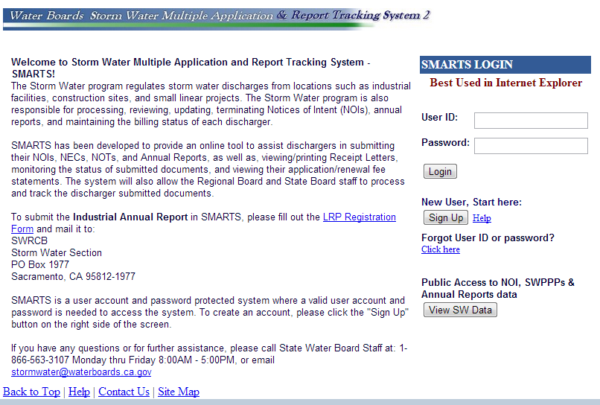
Water Pollution Control:
NPDES
https://Smarts.waterboards.ca.gov/smarts/SwSmartsLogin.jsp
Notes:
Trainer Notes:
How documents are electronically filed:
SMARTS: Storm Water Multiple Applications and Report Tracking System

Slide 50
Water Pollution Control:
Federal Laws and Regulations
Who monitors WPC and issues NPDES permits in CA?
State Water Resources Control Board (SWRCB)
Regional Water Quality Control Board (RWQCB)
Notes:
Trainer Notes:
Example of RWQCB

Slide 51
Water Pollution Control:
Implementation
  Where WPC (WPCP and SWPPP) must be implemented at:
  Project site
  Support facilities
  Staging areas
  Storage yards
  Mobile operations
  Batch plants for PCC and HMA
  Crushing plants for rock and aggregate
  Haul roads
Notes:
Trainer Notes:
This referring to batch plants and crushing plants set up for your job. Commercial plants have their own permits and requirements.

Slide 52
Water Pollution Control:
Implementation
        SWPPP or WPCP
        Before the work starts:
  Designate staff as storm water inspector
  Review contract and RE file
  Discuss WPC requirements at pre-job
Notes:
Trainer Notes:

Slide 53
Water Pollution Control:
Implementation
        SWPPP or WPCP
Before the work starts, review and accept the contractor’s SWPPP or WPCP.
The contractor must:
  Provide a WPC manager
  Conduct water pollution control training
  Monitor, inspect, correct WPC practices
Notes:
Trainer Notes:
WPC = water pollution control

Slide 54
Water Pollution Control:
Implementation
        SWPPP or WPCP
Before the work starts, ensure that the contractor:
  Includes support facilities in plan
  Submits Notice of Intent approved by the RWQCB
  Trains employees
Notes:
Trainer Notes:
WPC = water pollution control
Contractor must submit a copy of the NOI
Initial training must take place before work starts, then weekly training during progress

Slide 55
Water Pollution Control:
Implementation
        SWPPP or WPCP
  Verify copy of plan is on site
  Ensure BMPs are in place as required
  Confirm qualifications of Contractors WPC Manager:
  SWPPP QSD
  WPCP QSP
Notes:
Trainer Notes:
QSD = Qualified SWPPP Developer – Certified or Registered Professional
QSP = Qualified SWPPP Practitioner – Trained Person
BMPs = Best Management Practices
BMPs = Water Pollution Control Practices (now)

Slide 56
Water Pollution Control:
Implementation
SWPPP Only
  Confirm a Waste discharge ID number is issued prior to start of project
  Storm Water Annual Report is submitted (Sept.)
Notes:
Trainer Notes:
Examples of possible inspections and reports
Site Inspection Reports
Visual Monitoring Reports
Effluent Limit Violation Reports

Slide 57
Water Pollution Control:
Implementation
During construction, ensure the contractor:
  Performs inspections
  Submits reports
  Repairs/replaces damaged BMPs
  Reports discharges
  Samples (SWPPP only)
Notes:
Trainer Notes:
Examples of possible inspections and reports
Site Inspection Reports
Visual Monitoring Reports
Effluent Limit Violation Reports

Slide 58
Water Pollution Control:
Implementation
During construction, ensure the contractor:
  Stabilizes soil
  Controls sediment
  Prevents tracking
  Uses concrete washouts
Notes:
Trainer Notes:
Examples of possible inspections and reports
Site Inspection Reports
Visual Monitoring Reports
Effluent Limit Violation Reports

Slide 59
Water Pollution Control:
Implementation
During construction, ensure the contractor performs dewatering properly:
Follows CT Field Guide for Construction Site Dewatering
Causes no erosion, scour, sedimentary deposits
Discharges within the project limits
Does NOT discharge water that has odor, oily sheen, foam
Notes:
Trainer Notes:
Dewatering: Discharging stormwater, groundwater or surface water from excavations or temporary containment facilities.

Slide 60
Water Pollution Control:
Resources
  Chap. 13, WPC, CTSS 2015
  CT manuals
  CT Stormwater and Water Pollution Control website
  Storm Water Pollution Prevention training courses
Notes:
Trainer Notes:
CTSS = CT Standard Specifications
CTCM = CT Construction Manual
Training Courses and Manuals can be found at the CT website. Next slide provides address.

Slide 61
Water Pollution Control:
Resources
CT Manuals:
  Storm Water Management Enforcement Guidance
  Field Guide for Construction Site Dewatering
  SWPPP- WPCP Preparation
  Construction Site BMPs
  Chapter 7, CT CM
Notes:
Trainer Notes:
CTSS = CT Standard Specifications
CTCM = CT Construction Manual
Training Courses and Manuals can be found at the CT website. Upcoming slide provides web address.

Slide 62
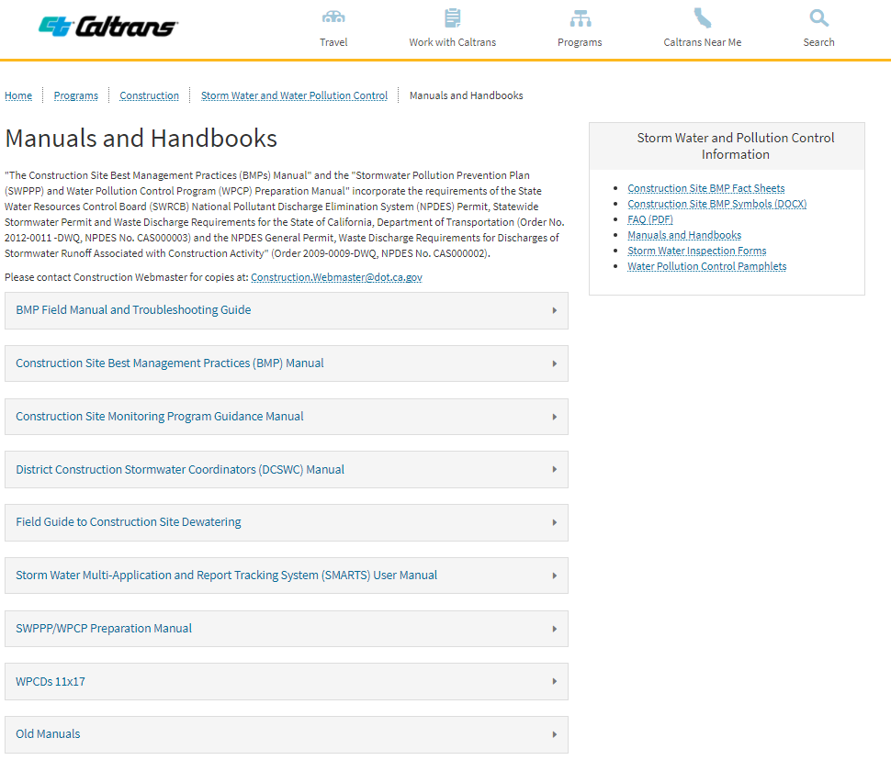
Manuals and Handbooks
https://dot.ca.gov/programs/construction/storm-water-and-water-pollution-control/manuals-and-handbooks
Notes:
Trainer Notes:

Slide 63
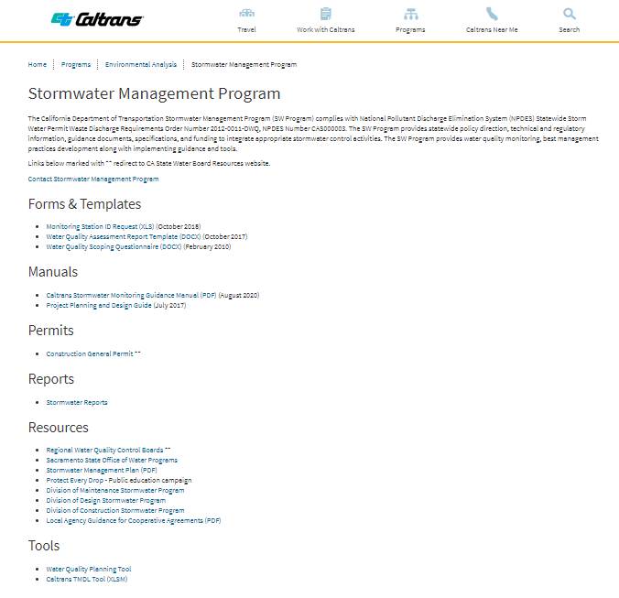
Water Pollution Control:
https://dot.ca.gov/programs/environmental-analysis/stormwater-management-program
Notes:
Trainer Notes:

Slide 64
Water Pollution Control:
Documents
WPC Project File Documents:
  SWPPP or WPCP
  Contractor’s weekly Site Inspection Reports
  Notice of Discharge Reports
  All correspondence related to WPC
Notes:
Trainer Notes:
Some items listed only apply to SWPPP jobs (SMARTS printout)
Not all jobs will have all items (ex. Notice of Discharge may not have been necessary)
NOT = Notice of Termination

Slide 65
Water Pollution Control:
Documents
WPC Project File Documents (cont.):
  RE/Asst. RE Inspection Reports
  Copies of Certifications required by specs
  SMARTS printout after filing NOT
Notes:
Trainer Notes:
Some items listed only apply to SWPPP jobs (SMARTS printout)
Not all jobs will have all items (ex. Notice of Discharge may not have been necessary)
NOT = Notice of Termination

Slide 66
Water Pollution Control
Quiz
Notes:
Trainer Notes:

Slide 67
Water Pollution Control:
Quiz
True or False
The Clean Water Act and Title 40 of the CFRs require projects that disturb 1 acre or more of soil be covered under the NPDES Construction General Permit, and to develop a SWPPP.
Notes:
Trainer Notes:
Stormwater discharges from construction activities are regulated under the National Pollutant Discharge Elimination System (NPDES) stormwater program. Prior to discharging stormwater, construction operators must obtain coverage under an NPDES permit, which is administered by the State (which is authorized by EPA to operate an NPDES stormwater program).
Construction stormwater discharges are almost all permitted under the Construction General Permit (CGP). The CGP is a type of of NPDES permit made to cover storm water discharges from construction projects. The CGP has several requirements, including development of a SWPPP. Construction operators intending to seek coverage under EPA's CGP must submit a Notice of Intent (NOI) certifying that they have met the permit’s eligibility conditions and that they will comply with the permit’s effluent limits and other requirements.

Slide 68
Water Pollution Control:
Quiz
True or False
The Clean Water Act and Title 40 of the CFRs require projects that disturb 1 acre or more of soil be covered under the NPDES Construction General Permit, and to develop a SWPPP.
True
Notes:
Trainer Notes:
Stormwater discharges from construction activities are regulated under the National Pollutant Discharge Elimination System (NPDES) stormwater program. Prior to discharging stormwater, construction operators must obtain coverage under an NPDES permit, which is administered by the State (which is authorized by EPA to operate an NPDES stormwater program).
Construction stormwater discharges are almost all permitted under the Construction General Permit (CGP). The CGP is a type of of NPDES permit made to cover storm water discharges from construction projects. The CGP has several requirements, including development of a SWPPP. Construction operators intending to seek coverage under EPA's CGP must submit a Notice of Intent (NOI) certifying that they have met the permit’s eligibility conditions and that they will comply with the permit’s effluent limits and other requirements.

Slide 69
Water Pollution Control
Quiz
Notes:
Trainer Notes:

Slide 70
Water Pollution Control:
Quiz
Choose the most correct statement:
A project that disturbs less than 1 acre does not require WPC.
A project that disturbs less than 1 acre requires a SWPPP.
A project that disturbs less than 1 acre requires a WPCP.
A project that disturbs less than 1 acre requires a SWPPP and a WPCP.
Notes:
Trainer Notes:

Slide 71
Water Pollution Control:
Quiz
Choose the most correct statement:
A project that disturbs less than 1 acre does not require WPC.
A project that disturbs less than 1 acre requires a SWPPP.
A project that disturbs less than 1 acre requires a WPCP.
A project that disturbs less than 1 acre requires a SWPPP and a WPCP.
Notes:
Trainer Notes:

Slide 72
Water Pollution Control
Quiz
Notes:
Trainer Notes:

Slide 73
Water Pollution Control:
Quiz
True or False
The RE is responsible to develop and implement the SWPPP, and monitor, inspect and correct water pollution control practices.
Notes:
Trainer Notes:

Slide 74
Water Pollution Control:
Quiz
True or False
The RE is responsible to develop and implement the SWPPP, and monitor, inspect and correct water pollution control practices.
False
The contractor is responsible. The RE ensures the contractor is doing these things and takes action if not.
Notes:
Trainer Notes:

