Slide 1
Project Completion
Notes:
Trainer Notes:

Slide 2
Project Completion:
Objectives:
Be able to:
  Perform a Final Inspection
  Know When to Release Final Retention to Contractor
  Know When to Submit As-Built Plans
  Assemble a Federal Report of Expenditures (Chapter 17 of LAPM)
  Understand the Consequences of Non-Compliance
Notes:
Trainer Notes:
Chapter 5, Accounting and Invoices
Chapter 17, Project Completion
Chapter 20, Deficiencies and Sanctions

Slide 3
Project Completion:
Perform Final Inspection
All Federal-aid Projects
  RE must perform final inspection:
Document fulfillment of Environmental Mitigation Commitments (use ECR)
Develop a punch list
Verify corrective actions completed by Contractor
Complete Items 1-10 of the Final Inspection Form (Exh. 17-C)
Submit form to the Caltrans DLAE
Notes:
Trainer Notes:
Neither FHWA or CT need to be involved in inspection at this time, but they should conduct their inspection before releasing contractor.
If you are not the responsible Person in Charge (RPC) – it is recommended the RPC attend the final inspection.
The local agency representative performing final inspection or signing the Final Inspection Form shall be one with authority for accepting the completed contract on behalf of the local agency and authorizing final payment to the contractor, as well as directing corrective action(s) to be undertaken by the contractor.

Slide 4
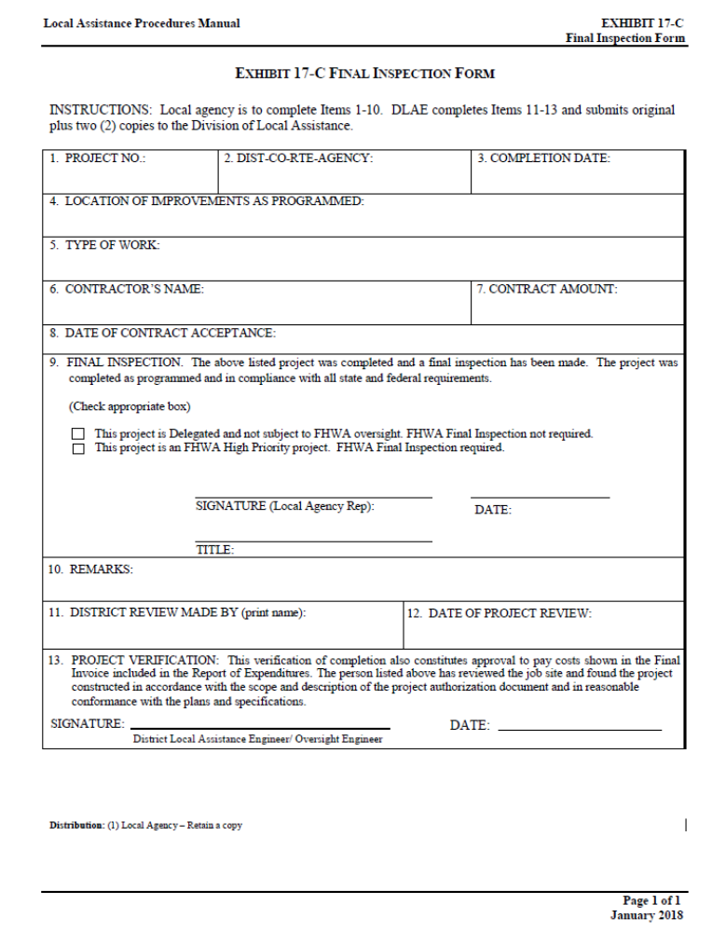
Final Inspection Form
LAPM Exhibit 17-C
(Handout Pg. 1)
Notes:
Trainer Notes:
Item 9: Most projects will check the first box, “Delegated”.

Slide 5
Project Completion:
Perform Final Inspection
  DLAE performs project verification:
    Reviews the job site
    Verifies construction per scope and description
    Completes Items 11-13 (Exh. 17-C) and signs
    Provides signed copy to agency
Notes:
Trainer Notes:
The DLAE will request correction to any safety, design or construction deficiencies, so it is helpful to keep the contractor onboard until the DLAE signs off.

Slide 6
Project Completion:
Release Final Retention
  Contractor has fulfilled Contract :
    All physical work including punch list is completed and accepted by Owner
    All certified payrolls are submitted /accepted
    Contractor submits and Owner approves
    EXHIBIT 17-F FINAL REPORT-UTILIZATION OF DISADVANTAGED BUSINESS ENTERPRISES (DBE) AND FIRST-TIER SUBCONTRACTORS
    Any other outstanding issues are resolved
Notes:
Trainer Notes:
Make sure to keep the DLAE informed of any outstanding issues that may cause delays.

Slide 7
Project Completion:
Submit As-Built Plans
Complete and Submit to DLAE:
On State Highway System:
Submit full set of As-Built Plans
Off State Highway System:
Submit Structure As-Built Plans Only

Slide 8
Project Completion:
Submit As-Built Plans
Caltrans Structure Maintenance and Investigations:
  Performs bridge inspections
  Makes repair recommendations
  Determines load capacity
  12,000 State Highway bridges
  12,200 Local Agency bridges
Notes:
Trainer Notes:
CT MUST get AS-Builts of all federal-aid bridges because federal regulations, required Caltrans perform inspections every 2 years
As-builts are used when determining scour issues

Slide 9
Project Completion:
Submit As-Built Plans
Complete and Submit to DLAE:
Structure “As Builts” to DLAE
  MUST be made by the engineer responsible for the Structures work
Cover Letter for the Report of Completion of Structures (Exh. 17-I)
Report of Completion of Structures (Exh. 17-J)
Notes:
Trainer Notes:
If the project is OFF the SHS, CT just wants the Structures AS-Builts,
“As Built” for the roadwork portion of the plans should be recorded in accordance with local agency requirements.
a set of original record drawings with “As Built” corrections, or
a clear, readable, black-line copy of the original tracings with “As Built” corrections
Each sheet of the As-Built plans must be clearly identified with an As-Built stamp. All plan sheets, whether they contain changes or not, must have (at a minimum) the name of the Resident Engineer (R.E.), the Construction Contract Acceptance date, and the Contract Number.

Slide 10
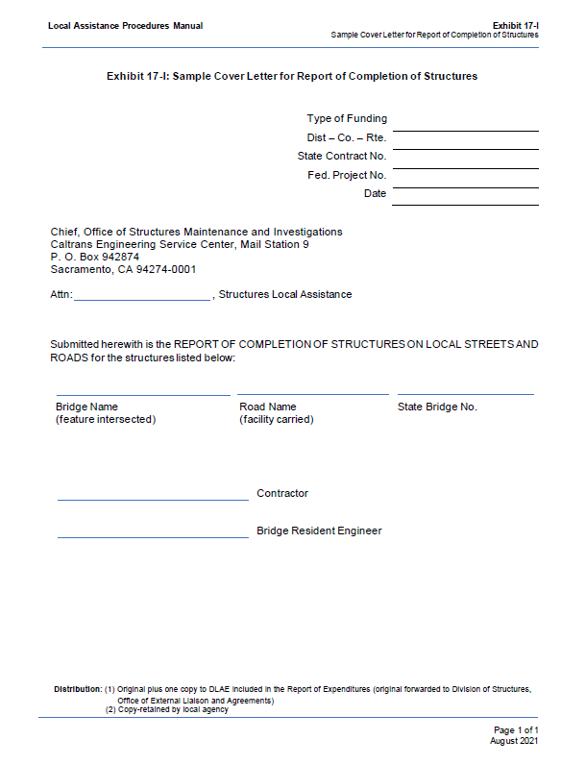
Cover Letter
Report of Completion of Structures
LAPM Exhibit 17-I
(Handout Pg. 2)
Notes:
Trainer Notes:

Slide 11
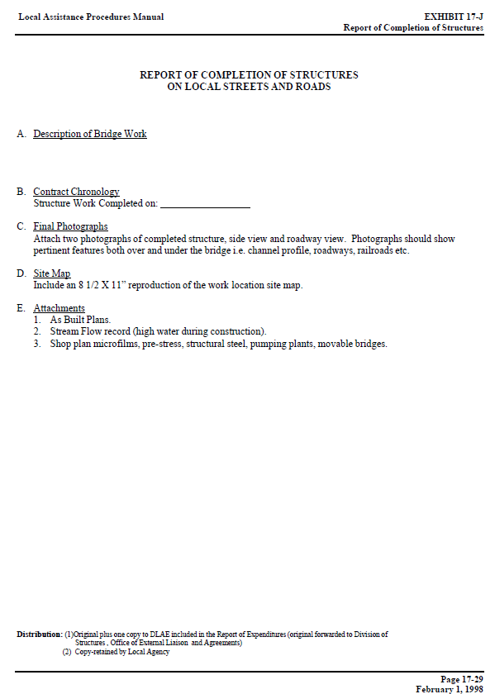
Report of Completion of Structures on Local Streets and Roads
LAPM Exhibit 17-J
(Handout Pg. 3)
Notes:
Trainer Notes:
Include photos, site map and as-builts
Also include stream flow records of high water during construction

Slide 12
Project Completion:
Assemble Report of Expenditures
  “Report of Expenditure” =
  Collection of Final Project Report Documents Required for Federal-Aid Projects
    Agency submits to DLAE
    Within 6 months after project completion
    Signed by Person in Responsible Charge
    DLAE reviews and forwards to Local Program Accounting (LPA) for processing
Notes:
Trainer Notes:
If timely submittals are not received, Caltrans shall initiate actions.
You can lose your funding if you do not get this in. Inactive projects are being tracked closely. FHWA does not want money sitting around, they figure, if you are not going to spend it, they will give it to someone who will.
DLAE shall perform a review of these documents for correct format and obvious errors and/or omissions.
Upon verification that the Report of Expenditures is complete, the DLAE shall forward it to accounting for processing.

Slide 13
Project Completion:
Assemble Report of Expenditures
Report of Expenditures must include:
Cover Letter and Federal Report of Expenditures Checklist (Exh. 17-A)
Final Inspection Forms (Exh. 17-C)
Final Detailed Estimate
Final Invoice Package
Change Order Summary
Final Report of DBE Utilization (Exh. 17-F)
DBE Status Change (Exh. 17-O)
Materials Certificate (Exh. 17-G)
Cover Letter and Structures Completion (Exh. 17-I and 17-J)
Report of Completion R of W Expenditures (Exh. 17-K)
Notes:
Trainer Notes:
For federal-aid projects, the Report of Expenditures includes, as a minimum, the following documents:
We are going to go over a few of them quickly.

Slide 14
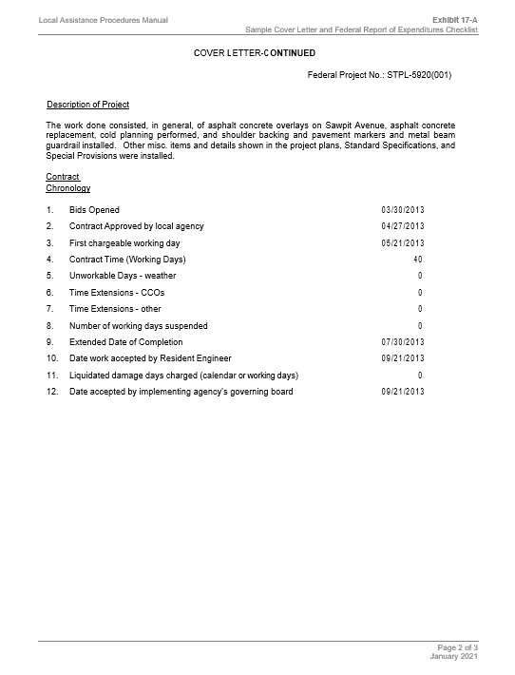
1. Report of
Expenditures
Cover Letter
LAPM Exh. 17-A
(Handout Pg. 5)
Notes:
Trainer Notes:
The first page is the cover letter (not shown on slides) and is in your handouts page 4.
The second page of 17-A is handout pg 5. You will need consult your Weekly Statement of Working Days to complete the contract Chronology.

Slide 15
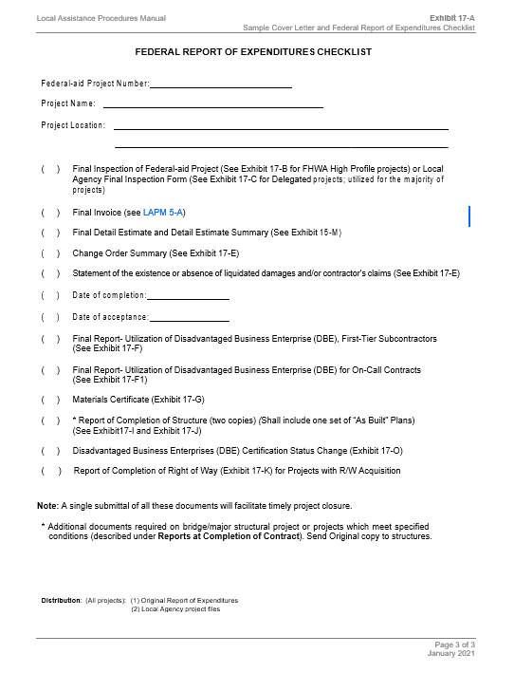
1. Report of
Expenditures
Cover Letter
(Handout Pg. 6)
Notes:
Trainer Notes:
Third page of 17-A, Checklist to remind you what you need. Some of the dates needed are repeated from the previous page.

Slide 16
Project Completion:
Assemble Report of Expenditures
  Final Inspection Forms (Exh. 17-C)
  Final Detailed Estimate (Exh. 15-M)
  Total of previous progress payments plus the final invoice
  Prepared only after claims are resolved
  Must agree with the Final Invoice
Notes:
Trainer Notes:
2. Final Inspection – just covered in earlier slides
3. – Same as “Detail Estimate” except that it labeled “Final” and show the total of previous progress payments plus the final invoice.

Slide 17
Project Completion:
Assemble Report of Expenditures
  Final Invoice Package
    Must conform to format(s) and requirements of LAPM Chapter 5 and agree with Final Detailed Estimate
    Must include RBI (Risk-Based Invoicing) Local Agency Invoice Review Checklist and Project Cost Summaries conforming to LAPM Chapter 5
Notes:
Trainer Notes:
Again, the numbers in the final invoice and final detailed estimate must match.

Slide 18
Project Completion:
Assemble Report of Expenditures
  4. Final Invoice Package (cont.)
Per Chapter 5: What may be reimbursable?
  Construction Engineering Costs, if listed on the ‘”Authorization to Proceed”. Salaries and wages, related to:
  Supervising and inspecting construction activities
  Staking
  Testing material
  Checking shop drawings
  Preparation of pay estimates, etc.
Notes:
Trainer Notes:
NOTE - Construction Engineering costs must be listed on the “Authorization to Proceed” (E-76) to be eligible for reimbursement.
Funds can be moved between CE and CON as needed.

Slide 19
Project Completion:
Assemble Report of Expenditures
  4. Final Invoice Package (cont.)
Per Chapter 5: What may be reimbursable?
  Construction Costs
  Actual costs to construct the facility
  Removal, adjustment or demolition of buildings/structures
  Utilities or railroad work that is a part of the physical construction of the project
  Administrative Settlement Costs:
  Related to the review and defense of claims
      All costs must be broken down into eligible direct and/or indirect cost components.
Notes:
Trainer Notes:
Construction costs: Actual costs to construct the transportation facility and its appurtenant facilities. (what you paid the contractor -item payments and cco payments- to construct the project)
Consultant Audit Costs: For consultant contracts over $150K. See Chapter 10, consultant selection.

Slide 20
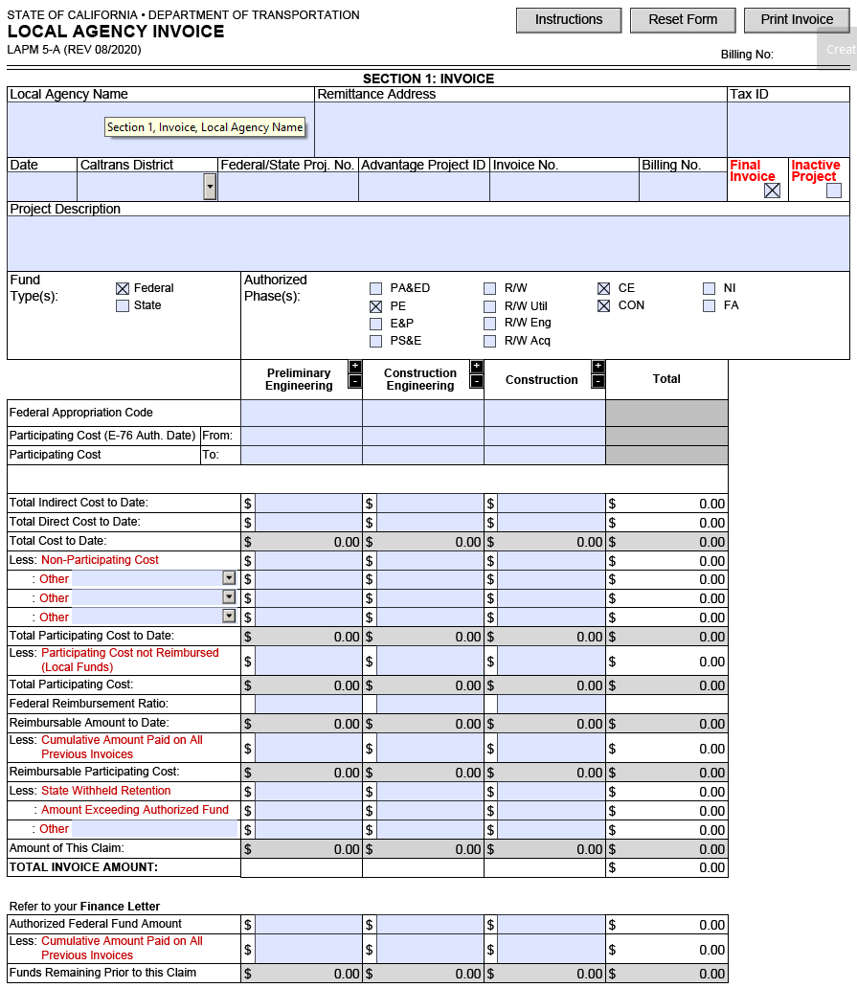
4. Federal-Aid Final Invoice Page 1
LAPM Chapter 5
Exhibits 5-A (2020)
Project closeout requires submittal of the Final Invoice and related exhibits. For specifics, refer to the LAPM or contact your District Local Assistance Engineer.
FINAL CLOSEOUT PACKAGES:
One (1) Original Invoice – (1) dated, signed (blue ink) printed on agency letterhead, formatted as required: http://www.dot.ca.gov/hq/LocalPrograms/lam/forms/lapmforms.htm
Two (2) copies of Invoice (or as directed by DLAE)
Two (2) Exhibit 5-J – Local Agency Invoice Review Checklist
Two (2) Exhibit Project Expense Summary(ies)
  Support expense summary (i.e., PE, CE, ROW E&A)
  Capital expense summary (CON and ROW Acquisition)
  Final Report of Expenditures, etc…, as noted per LAPM
MAIL INVOICE PACKAGE TO:
District DLAE, Caltrans Local Assistance (address particular to your agency’s District Local Assistance office)
*** Do not send Final Invoice packets to Caltrans HQ in Sacramento ***
Notes:
Trainer Notes:
Show actual 5-A, click on the Final box, PE, CE and CON. Can click on ROW column too. Data from all phases are entered in the final invoice.

Slide 21
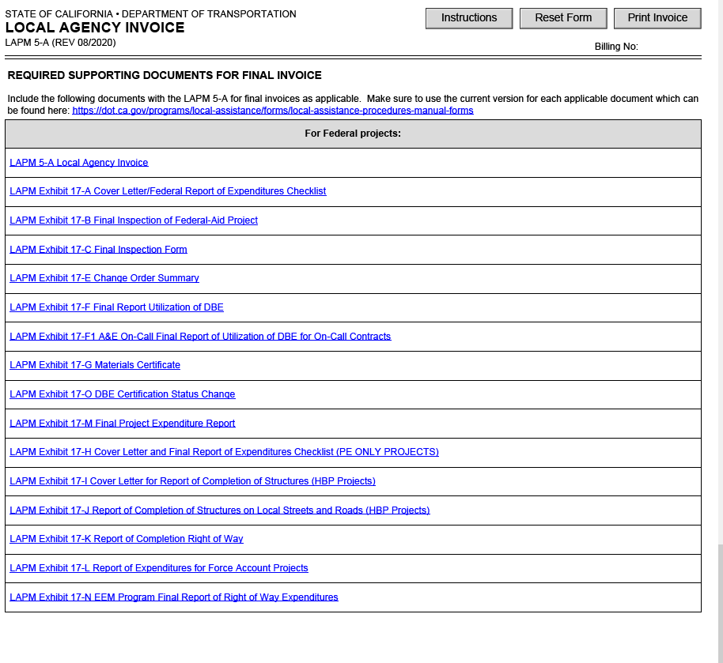
4. Federal-Aid Final Invoice Supporting Documents
LAPM Chapter 5
Exhibit 5-A
(for Final Invoices)
Notes:
Trainer Notes:
Last page of 5-A when the Final Invoice box is checked. Blank copies of the forms are opened when link is clicked.

Slide 22
Project Completion:
Assemble Report of Expenditures
Change Order Summary
  List must conform to sample form Exh. 17-E
  If no CCOs written, write “none”
  Include following additional information:
  Liquidated Damages:
  Number of LD days
  Amount per day
  Total amount LD charged
  If no LDs charged, note “none”
  Contractor’s Claims
  If no contractor’s claims, note “none”
  Date of acceptance
Notes:
Trainer Notes:
5. CCO Summary: Required even if no CCOs were written.
For more information on contract claims, RE’s can read Chapter 16.15, Contract Claims of LAPM

Slide 23
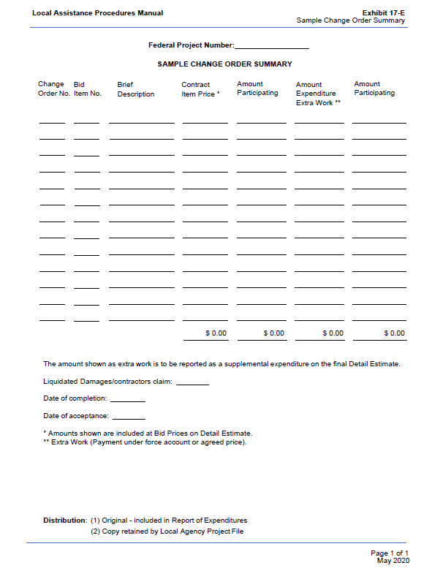
Project Completion:
Assemble Report of Expenditures
5. CCO Summary
LAPM Exhibit 17-E
(Handout Pg. 20)
Notes:
Trainer Notes:
Remember, for some funding programs, CCOs that change scope and/or cost may need to be pre-approved by Caltrans or CTC. So this list can be shared with DLAE as the project progresses.

Slide 24
Project Completion:
Assemble Report of Expenditures
Final Report – Utilization of Disadvantaged Business Enterprises (DBE) (Exh. 17-F)
Disadvantaged Business Enterprises (DBE) Certification Status Change (Exh. 17-O)
  If no changes, state “Not Applicable”
Notes:
Trainer Notes:
17-F and 17-O are submitted by Prime and checked by Local Agency

Slide 25
Project Completion:
Assemble Report of Expenditures
Materials Certificate
  Use Exh. 17-G
  Documentation must be attached including explanations and change orders allowing acceptance of nonconforming materials
Report of Completion of Right of Way Expenditures
  Use Exh. 17-K
  Submitted when final R/W costs are known
Notes:
Trainer Notes:

Slide 26
Project Completion:
Assemble Report of Expenditures
Special Cases:
State Funded Projects – Complete the “Final Project Expenditure Report” (Exh. 17-M)
  Check “State” on Invoice 5-A
Force Account Projects – Complete the “Report of Expenditures for Force Account Projects” (Exh. 17-L)
Notes:
Trainer Notes:
State Funded package is only the 5-A and 17-M

Slide 27
Project Completion:
Noncompliance and Consequences
Failure to submit Report of Expenditure
    = Sanctions
Final Invoice and Final Detail Estimate do not match
  = Delayed payment
Previously billing for
  items not reimbursable by the FHWA; and
  amounts exceeding the final quantities
    = State will bill you for re-payment
Notes:
Trainer Notes:
Failure to resolve issues in a timely manner could result in the State billing for all expenditures made on the project.
Caltrans shall initiate action with the State Controller to offset funds due from the local agency.

Slide 28
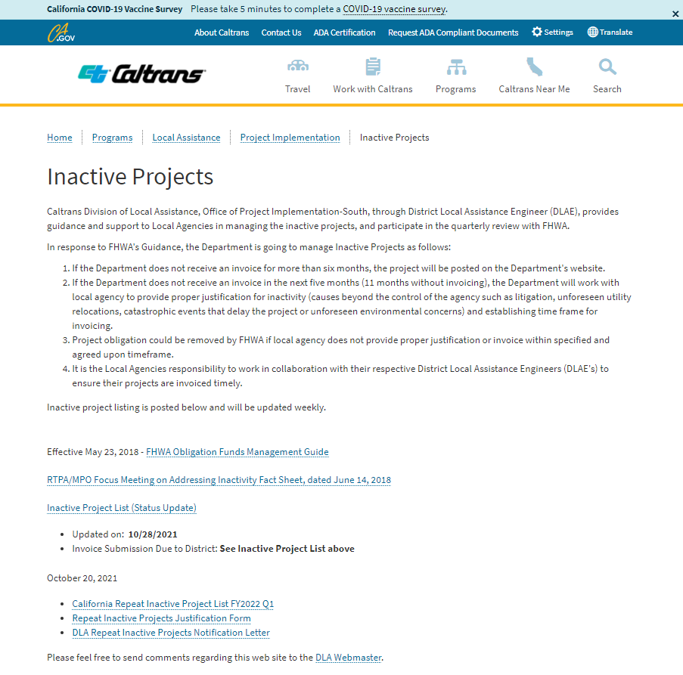
Inactive Projects
https://dot.ca.gov/programs/local-assistance/projects/inactive-projects
Notes:
Trainer Notes:
Your DLAE will probably be in touch with your Person in Responsible Charge if your project makes the inactive list.
Projects need invoices processed at least every 6 months. Plan ahead, you may want to hold back some charges to cover times when no new charges are coming in.

Slide 29
Project Completion:
Noncompliance and Consequences
Project Deficiencies:
Procedural:
  Local Agency procedures do not follow LAPM
Correctable
Major:
Violates state or federal state law or regulation
If uncorrected, would prevent federal or state participation in all or a portion of the project
Unrecoverable:
Such magnitude as to create doubt that the policies and objectives of Title 23 of the USC will be accomplished by the project
Project beyond point that the deficiency can be corrected
Loss of all or a portion of the federal and/or state funds
Notes:
Trainer Notes:
Procedural Examples:
Continued submission of required forms that contain errors and omissions.
Major Examples: failure to ….
Submit “Materials Certification”
Enforce DBE provisions
Fulfill mitigation commitments
Failure to Maintain the completed project. (shall result in repayment).
Unrecoverable Examples: using …
Using hiring preferences
Using foreign steel or iron
Payments to a contractor for items of work that was designated for a DBE but performed by others, and there is no documentation for the substitution that was approved,
Consultant contract awarded without a competitive process.
Failure to have a Local Agency employee as Responsible Person in Charge.

Slide 30
Project Completion:
Noncompliance and Consequences
Sanctions
  Freeze future programming
  Freeze progress payments
  Withdraw % of project funds
  Withdraw all the project funds
A Local Assistance Dispute Resolution Process exists for you to appeal the sanctions.
Notes:
Trainer Notes:

Slide 31
Project Completion:
Construction Records and Accounting
Project Records Retention:
Required by law: 23 CFR 710
3 years after date of final voucher approved
All records
Notes:
Trainer Notes:
It is NOT 3 years from contract acceptance.
The approved final voucher is when FHWA signs off on the final reimbursement payment for the project. The DLAE will send you a notice and a “final voucher” E-76.
If a project has claims, this can be much later than project acceptance.
What do you have to save? :Any information recorded or received, or data generated by the agency or its agents in connection with the project become official records of that project and are subject to the records retention requirements as described in 23 CFR 710.201(f).
Written data may be microfilmed or scanned electronically and used in lieu of original records.

