Slide 1
Prosecution and Progress
Notes:
Trainer Notes:

Slide 2
Prosecution and Progress:
Objectives
List key features of a CPM Schedule
Determine a working day from a non-working day
Complete a Weekly Statement of Working Days
Notes:
Trainer Notes:

Slide 3
Prosecution and Progress:
Resources
LAPM 16.6 Contract Time
Chapter 8, Caltrans Standard Specifications
Chapter 6, Green Book
Notes:
Trainer Notes:

Slide 4
Prosecution and Progress:
Schedule
A schedule should:
Monitor and evaluate progress
Determine controlling operation
Analyze time impacts
Display milestones
Notes:
Trainer Notes:
Time impacts from:
Changes
Delays
DSC
Examples of milestones:
placing traffic on detours or new pavement
beginning new phases of the work in staged construction
opening new structures or ramps

Slide 5
Prosecution and Progress:
Schedule
A Schedule is Required!
Contractor must submit…
  Prior to or at pre-Con (CTSS Level 1)
  W/in 20 days of Approval (CTSS Level 2 and Level 3)
  Prior to start of work (GB)
  CTSS 8-1.02 Schedule;
  Green Book Section 6-1.1 Construction Schedule
Notes:
Trainer Notes:
Make every effort to obtain a reasonable baseline schedule at the beginning of the contract.
Notify the contractor in advance if a progress payment will be withheld for failure to submit a satisfactory schedule.
Require the contractor to submit an updated or revised schedule monthly (CTSS only) or when significant changes occur in the project.
CTSS: Level 1 and level 2 specifications require that you request a revised schedule to evaluate alterations to the critical path or an extension to the completion date. For these levels, the revised schedule may be used in lieu of a time impact analysis.

Slide 6
Prosecution and Progress:
Schedule
  RE approves
  Contractor submits updates:
  Monthly (CTSS)
  If schedule fails to reflect progress (GB)
  If desire to make a major change (GB)
    CTSS 8-1.02 Schedule
    Green Book Section 6-1.1 Construction Schedule
Notes:
Trainer Notes:

Slide 7
Prosecution and Progress:
Schedule
Critical Path Method (CPM) Schedules
Activities
Durations
Logic ties
Grind (3d)
Stripe (1)
Pave (2d)
Con. Signs (1d)
Notes:
Trainer Notes:

Slide 8
Prosecution and Progress:
Schedule
Should you accept a schedule showing completion of work…
  before expiration of contract time?
  after time has expired?
What if the contractor does not turn in schedule updates?
  CTSS 8-1.02
  Green Book 6-1.1
  9-1.16E(3) Performance Failure Withholds
Notes:
Trainer Notes:
Submitted Schedules must be consistent with time requirements in the contract - example, the baseline should not show the contractor taking more days than there are WDs in the contract.
It is OK if he shows finishing early. But be sure to review the baseline carefully for reasonable durations and logical “logic ties” before you accept it. Also, be sure you have an updated schedule before you analyze a time impact. An updated schedule with as-build dates filled in will take into consideration if the contractor had an unrealistic baseline.
Withhold money on the progress payment for failure to
9-1.16E(3) Performance Failure Withholds

Slide 9
Prosecution and Progress:
Start of Job Site Activities (CTSS)
Contractor start job site activities within …
  15 days after Contract Approval. If SWPPP required, 55 days after approval.
Contractor to notify in writing 72 hours prior
to start
          CTSS 8-1.04 Start of Job Activities
Notes:
Trainer Notes:
Might be modified by your Special Provisions
If the project has work at more than one location, require submittal of a separate notice for each location.

Slide 10
Prosecution and Progress:
Start of Job Site Activities (GB)
Contractor start job site activities within …
  15 days after Notice to Proceed
Contractor to notify in writing 72 hours prior
to start
          Green Book 6-1.2 Commencement of Work
Notes:
Trainer Notes:
Might be modified by your Special Provisions
If the project has work at more than one location, require submittal of a separate notice for each location.

Slide 11
Prosecution and Progress:
Start of Contract Time (CTSS)
The contract time starts on the earlier of the following
  1. Day you start job site activities after Contract approval
  2. Last day specified to start job site activities in section 8-1.04
          CTSS 8-1.04 Start of Job Activities
Notes:
Trainer Notes:
Might be modified by your Special Provisions
If the project has work at more than one location, require submittal of a separate notice for each location.

Slide 12
Prosecution and Progress:
Start of Contract Time (GB)
Date of Notice to Proceed
          Green Book 6-1.2 Commencement of Work
Notes:
Trainer Notes:
Might be modified by your Special Provisions
If the project has work at more than one location, require submittal of a separate notice for each location.

Slide 13
Prosecution and Progress:
Tracking Time
Weekly Statement of Working Days (CTSS)
RE must issue written record of contract progress
Show:
  WDs and non-WDs during the reporting week
  Time adjustments
  Calculations of the work completion date computations
  Working days remaining
  Controlling activities
  CTSS 8-1.05 Time
  LAPM 16.6 Tracking Contract Time
Notes:
Trainer Notes:
23 CFR 635.121 Federal regulations require that you track contract time.
shall maintain a written record of project progress
LAPM 16.5 requires you to track contract time.
8-1.05 The Engineer issues a Weekly Statement of Working Days form by the end of the following week.
The Weekly Statement of Working Days form shows:
1. Working days and non–working days during the reporting week
2. Time adjustments
3. Calculations of work completion dates, including working days remaining
4. Controlling activities
Contractor has 15 days to file a written protest .
ASK CLASS: what are the two most common things a contractor protests:
The controlling activity
If a day was a working day (versus a non-working day).
Use the remarks portion of the WSWD to document any of these issues that affect contract time.
Weather, Delays, Strikes or labor disputes, Material shortages
Expand on issue in your Daily Report if necessary
More involved issues require more documentation - material shortage

Slide 14
Prosecution and Progress:
Tracking Time
“Periodic” Statement of Working Days (GB)
RE must issue written record of contract progress
Show:
  WDs charged during reporting period
  Time adjustments
  Working days remaining
  Green Book 6-3.2 Contract Time Accounting and
  6-4.2 Extension of Time
Notes:
Trainer Notes:
23 CFR 635.121 Federal regulations require that you track contract time.
shall maintain a written record of project progress
LAPM 16.5 requires you to track contract time.
Contractor has 15 days to file a written protest .
ASK CLASS: what are the two most common things a contractor protests:
The controlling activity
If a day was a working day (versus a non-working day).
Use the remarks portion of the WSWD to document any of these issues that affect contract time.
Weather, Delays, Strikes or labor disputes, Material shortages
Expand on issue in your Daily Report if necessary
More involved issues require more documentation - material shortage (contractor forgot to order, or is way down the list of priority is not a material shortage)
GB users, I recommend you record the controlling operation – Section 6-4.2 Extensions for Time, says they “ will not be granted for non-controlling delays to minor portions of the work
6-4.2 Extensions of time when granted, will be based upon the effect of delays to the Work. They will not be granted for non-controlling delays to minor portions of the Work unless it can be shown that such delays did or will delay the progress of the Work.

Slide 15
Prosecution and Progress:
Time
Working Day (CTSS)
Any day except
  Saturday and holiday
  Day when you cannot perform work on the controlling activity for at least 50 percent of the day with at least 50 percent of the normal labor and equipment due to any of the following:
Weather
Maintaining traffic under contract
Unanticipated event
Issue involving third party
CTSS 1.107 Definitions
Notes:
Trainer Notes:
What is a working day? … see slide
What about Sunday? Per State law, Sunday is defined as a holiday in CTSS Section 1.107.
How do you know how many working days in your contract? Stated in the Notice to Bidder or Special Provisions
Maintaining Traffic Under Contract:
Example, the contract says no lane closures are allowed on Fridays
Unanticipated event not caused by either party such as:
Act of God, Act of a public enemy.
Fire, Flood, Landslide
Governor-declared state of emergency.
Epidemic, Quarantine restriction.
2.2.5. Issue involving a third party, including:
2.2.5.1. Industry or area-wide labor strike.
2.2.5.2. Material shortage.
2.2.5.3. Freight embargo.
2.2.5.4. Jurisdictional requirement of a law enforcement agency.
2.2.5.5. Workforce labor dispute of a utility or nonhighway facility owner resulting in a nonhighway facility rearrangement not described and not solely for the Contractor's convenience. Rearrangement of a nonhighway facility includes installation, relocation, alteration, or removal of the facility.
.
Of course, read your contract to see if it the special provisions have changed anything.
ASK: What is a calendar day?
ANSWER: In 2010 CTSS A Day = A Calendar Day = 24 consecutive hours running midnight to midnight.

Slide 16
Prosecution and Progress:
Time
Working Day (GB)
Any day except
  Saturday, Sunday
  Agency designated holiday
  Contractor prevented from working…
    at beginning of the workday
    or the first 5 hours with at least 60 percent of the normal work force
    …for cause as specified in 6.61:
Weather
Maintaining traffic under contract
Unanticipated event
Issue involving third party
Green Book 1-2 Terms and Definitions
Notes:
Trainer Notes:
What is a working day? … see slide
What about Sunday? Per State law, Sunday is defined as a holiday in CTSS Section 1.107.
How do you know how many working days in your contract? Stated in the Notice to Bidder or Special Provisions
Maintaining Traffic Under Contract:
Example, the contract says no lane closures are allowed on Fridays
Unanticipated event not caused by either party such as:
Act of God, Act of a public enemy.
Fire, Flood, Landslide
Governor-declared state of emergency.
Epidemic, Quarantine restriction.
Examples of issues involving a third party:
Industry or area-wide labor strike.
Material shortage.
Of course, read your contract to see if it the special provisions have changed anything.
ASK: What is a calendar day?
ANSWER: In 2010 CTSS A Day = A Calendar Day = 24 consecutive hours running midnight to midnight.

Slide 17
Prosecution and Progress:
Time
Calendar Day (CTSS)
Day: 24 consecutive hours running from midnight to midnight; calendar day
CTSS 1.107 Definitions
Notes:
Trainer Notes:
Those using Calendar days, be sure you are tracking time as defined by your contract – the CTSS definition means Sat and Sunday, rain days, etc. each and every day. You can’t arbitrarily change the definition.

Slide 18
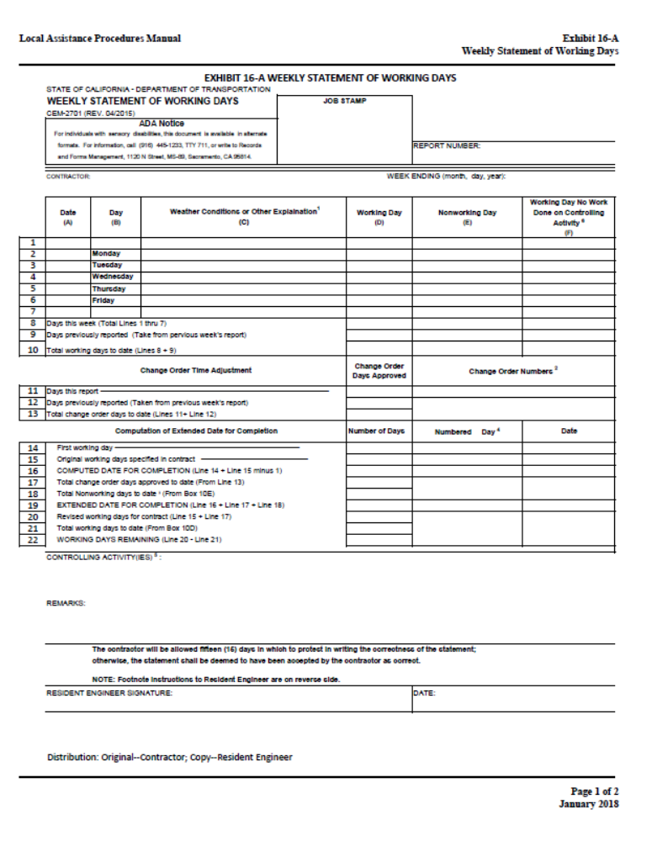
Weekly Statement of Working Days (Exhibit 16-A)
Notes:
Trainer Notes:

Slide 19
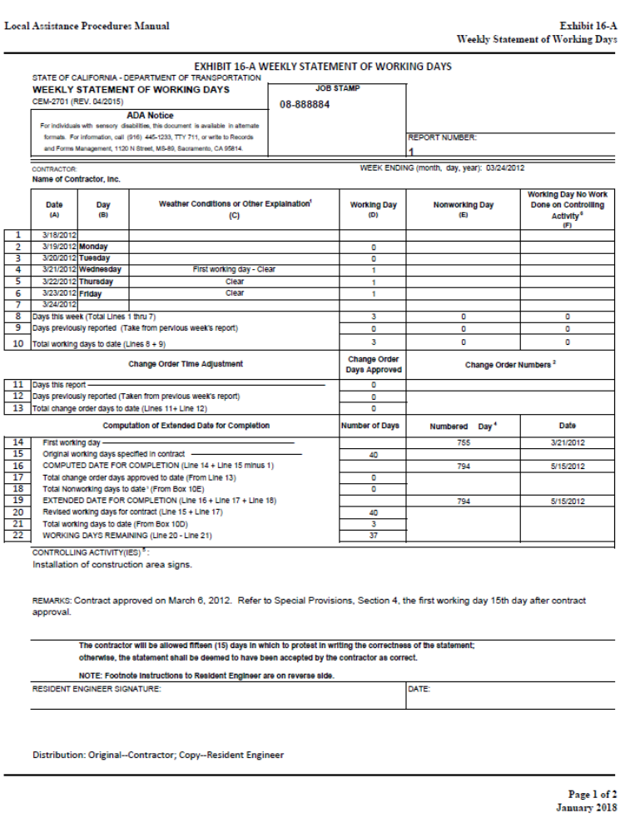
Sample completion of the first Weekly Statement of Working Days (Handout Pg. 2)
Notes:
Trainer Notes:

Slide 20
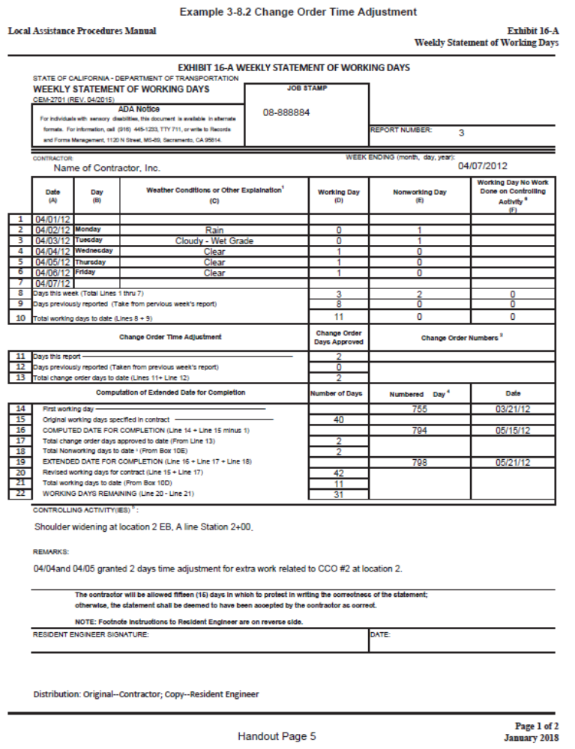
Sample completion of a CO time extension on the Weekly Statement of Working Days (Handout Pg. 3)
Notes:
Trainer Notes:

Slide 21
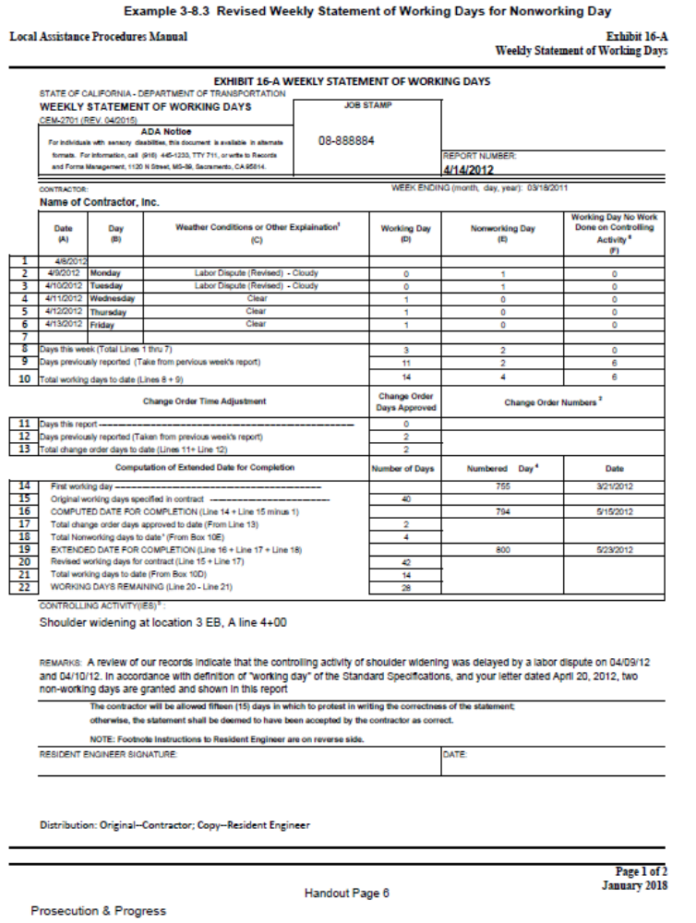
Sample completion of non-working days on the Weekly Statement of Working Days
(Handout Pg. 4)
Notes:
Trainer Notes:

Slide 22
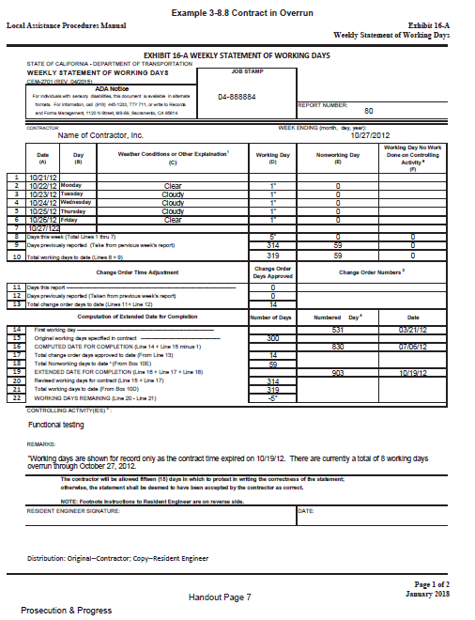
Sample completion of a contract in overrun on the Weekly Statement of Working Days
(Handout Pg. 5)
Notes:
Trainer Notes:

Slide 23
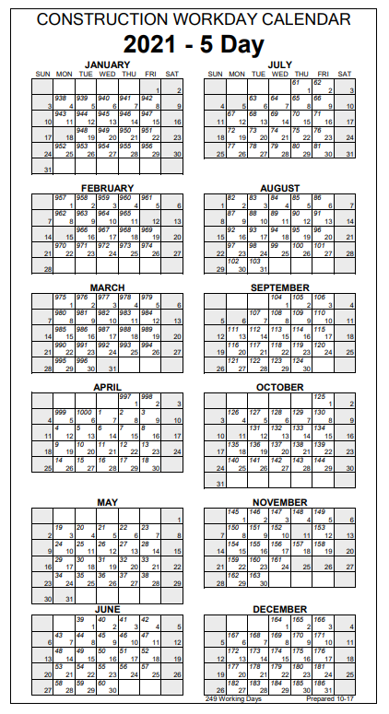
Construction
Workday Calendar
(5-Day)
https://dot.ca.gov/programs/construction/contract-time
2012
Notes:
Trainer Notes:
Work Day Calendar = 5 day per week, versus a 7 day per week calendar.

Slide 24
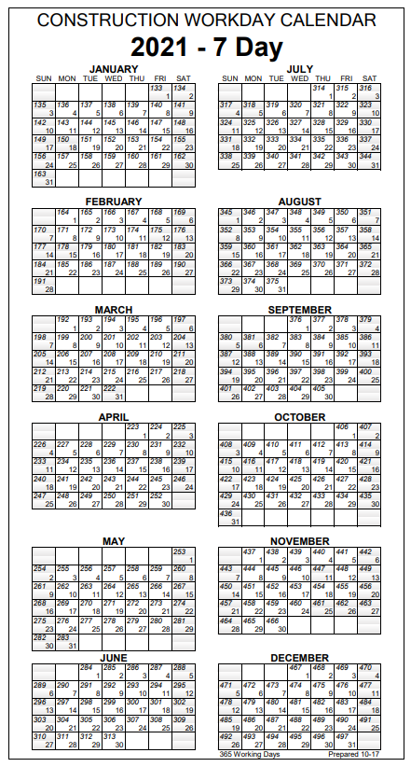
Construction
Workday Calendar
(7-Day)
https://dot.ca.gov/programs/construction/contract-time
2012
Notes:
Trainer Notes:
Work Day Calendar = 5 day per week, versus a 7 day per week calendar.

Slide 25
Contract Time
Exercise
Notes:
Trainer Notes:

Slide 26
Tab 7: Prosecution & Progress | Contract Time Exercise--WSWD
INSTRUCTIONS:
You, the RE on the project, are preparing the Weekly Statement of Working Days (WSWD) for the week ending June 4, 2021. Using WSWD Report Number 6 on the next slide and the “2021 Construction Workday Calendar” obtained from the Caltrans website, complete WSWD Report Number 7 and answer the questions below. See below for links to working day calendar and Exhibit 16-A. You will have 10 minutes to complete this exercise. One student will share their WSWD when we return together.
5/31/2021 – Holiday (Memorial Day)
6/1-3/2021 – Working Day
6/4/2021 – Non-working day due to rain
2 days added for approved CO #2
What is the extended date of completion (line #19)?
What is the number of working days remaining (line #22)?
Exhibit 16-A Weekly Statement of Working Days: https://dot.ca.gov/-/media/dot-media/programs/local-assistance/documents/lapm/c16/16a.pdf
2021 Caltrans working day calendar: https://dot.ca.gov/-/media/dot-media/programs/construction/documents/contract-administration/contract-time/working-day-calendars/2021-working-days-calendar-5-day.pdf

Slide 27
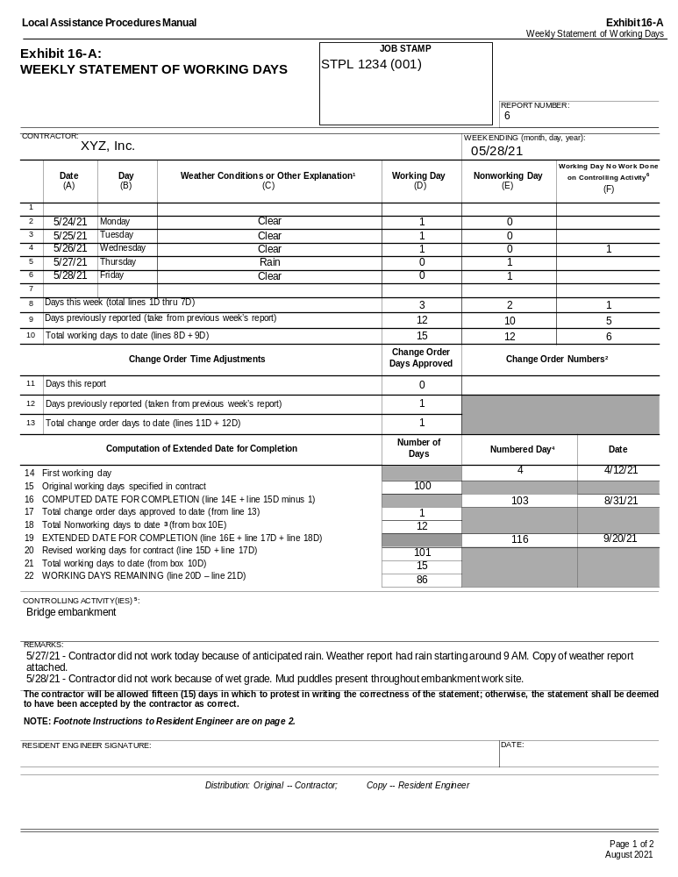
Contract Time Exercise WSWD Report 6
(Handout Page 6)
Notes:
Trainer Notes:

Slide 28
Prosecution and Progress:
Suspension
RE may suspend the work wholly or in part due to any of the following:
  Conditions are unsuitable for work progress
  Contractor fails to do any of the following:
      Fulfill the Engineer's orders
      Fulfill a Contract part
      Perform weather-dependent work when conditions are favorable so that weather-related unsuitable conditions are avoided or do not occur
      CTSS 8-1.06 Suspensions
Notes:
Trainer Notes:
Example of conditions unsuitable for work progress: extended wet weather, such as moving into the rainy season.
ASK: Who pays to provide a safe smooth passage?
8-1.06B Suspensions Unrelated to Contractor Performance
Costs to providing for a smooth and unobstructed passageway through the work is force account work.
The days are non–working days.
8-1.06C Suspensions Related to Contractor Performance
The Agency may provide for a smooth and unobstructed passageway through the work during the suspension and deduct the cost from payments.
The days are working days.

Slide 29
Prosecution and Progress:
Liquidated Damages
  Liquidated Damages (LDs) – Deduction of payment due contractor for each day’s delay in completing work beyond the time allowed
  Is not taking LDs OK?
  CO to extend contract time
  No documentation = FIN (Federal-aid Ineligibility Notice)
  CTSS 8-1.10 Liquidated Damages
  Green Book 6-9 Liquidated Damages
Notes:
Trainer Notes:
Required on Federal-aid projects
LD = Estimate of Field Construction Engineering (CE) Costs, including overhead
Calculated by Design staff following procedures in the LAPM
FIN: Federal-aid Ineligibility Notice: Notice to Agency that the Feds want some or all of their money back
LDs are different from Incentive/Disincentives (IDs) money.
LDs ensures the contractor completes the work efficiently and does not drag it out.
IDs – motivate contractor to complete segment of work
Open bridge before school starts
Open a ramp before a given date
Need good reason well supported to give time.

Slide 30
Prosecution and Progress:
Contractor Termination
You may terminate the contractor’s control of
the work for failure to do any of the following:
  Supply adequate work force
  Supply material as described
  Pay subcontractors
  Prosecute the work as described in the contract
  CTSS 8-1.13 Contractor’s Control Termination
  Green Book 6-4 Termination of Contract for Default
Notes:
Trainer Notes:
Two types of termination: contractor and contract. When you terminate the contractor, their bonding agent must step in and get the job finished or pay you value of the bond. (next slide covers contract termination)
Guidelines for determining if the contractor may be failing to supply an adequate workforce:
If the “percent completed” of the contract is more than 25 percent behind the “percent time elapsed.”
Complete cessation of the work.
The work has not started within a period equal to 10 percent of the original working days or 50 working days, whichever is less.
If the RE suspects termination may be necessary, the RE sends a letter to the contractor that describes:
the defaults to be remedied
amount of time allowed to remedy the defaults
and states that, in accordance with Section 8-1.13 [8-1.08], “Contractor’s Control Termination,” of the Standard Specifications, Agency will start the termination process if the defaults are not remedied.
A copy of this letter is sent to the contractor’s surety.
Typically, allow 5 business days to remedy either failure to supply an adequate work force or failure to supply proper quality material. Generally, 15 days are allowed to remedy failure to pay subcontractors.
Normally, when Caltrans terminates the contractor’s control, the surety (bonding company) assumes responsibility for completing the contract.
Consult your Senior and Manager. See CM for more guidance.

Slide 31
Prosecution and Progress:
Contract Termination
“Convenience Termination”
When it is not in Agency’s best interest to continue with the project
Allowed but rare
CTSS 8-1.14 Contract Termination
Notes:
Trainer Notes:
Just mention – don’t spend much time on this.
The contractor will be paid all reasonable costs as computed according to Section 8-1.14 [8-1.11], “Contract Termination,” of the Standard Specifications. An audit of the contractor’s cost records is normally required to resolve compensation issues.

Slide 32

Prosecution and Progress:
Quiz
Notes:
Trainer Notes:

Slide 33
Prosecution and Progress:
Quiz
Choose the correct answer.
For a project using the CTSS, before you can determine if last Wednesday was a working day on your project, you must first know:
Did it rain
Was there inclement weather
The controlling operation
Was the contractor prevented from working.
Notes:
Trainer Notes:

Slide 34
Prosecution and Progress:
Quiz
Choose the correct answer.
For a project using the CTSS, before you can determine if last Wednesday was a working day on your project, you must first know:
Did it rain
Was there inclement weather
The controlling operation
Was the contractor prevented from working.
Greenbook: d
Notes:
Trainer Notes:

Slide 35
Prosecution and Progress:
Quiz
Notes:
Trainer Notes:

Slide 36
Prosecution and Progress:
Quiz
True or False
It is important to list all major operations the contractor performed for the week on the Weekly Statement of Working Days.
Notes:
Trainer Notes:

Slide 37
Prosecution and Progress:
Quiz
True or False
It is important to list all major operations the contractor performed for the week on the Weekly Statement of Working Days.
False: Just list the controlling operation
Notes:
Trainer Notes:

Slide 38
Prosecution and Progress:
Quiz
Notes:
Trainer Notes:

Slide 39
Prosecution and Progress:
Quiz
True or False
If the contractor worked hard, did a good job and is a nice guy, it is OK to write a CO at the end of the job giving him days, so he does not get dinged for liquidated damages.
Notes:
Trainer Notes:

Slide 40
Prosecution and Progress:
Quiz
True or False
If the contractor worked hard, did a good job and is a nice guy, it is OK to write a CO at the end of the job giving him days, so he does not get dinged for liquidated damages.
False: All extensions of contract time
must be justified.
Notes:
Trainer Notes:

