Slide 1
Change Orders
(COs)
Notes:
Trainer Notes:

Slide 2
Change Orders:
Objectives
Be able to …
  Understand the purpose of a CO
  Determine if the CO is within the scope of your contract
  Write a CO
  Determine appropriate method of payment
  Write a CO memorandum
Notes:
Trainer Notes:

Slide 3
Change Orders:
Definition
A CO is…
A legally binding document used to make changes to the contract.
Notes:
Trainer Notes:
Signed by both parties or
Unilaterally approved: Just signed and executed by agency without Contractors agreement.
A CCO is approved when the Agency signs the CCO (this is generally not the RE signature)
If unilaterally approving a CCO, formally give the Contractor as he/she has 5 days to protest it or he/she agrees to the conditions.
Until given an approved CCO or written direction from the RE, the contractor should continue to perform the work per the contract documents.

Slide 4
Change Orders:
Purpose
Reasons for writing COs?
Change plans/specifications
Add work
LAPM 16.13 Change Orders
Notes:
Trainer Notes:
Work required, but not included in the contract = Extra Work.
Ask Question: HMA placed per plans but final quantity is greater than engineer's estimate. Do you write CCO?
Answer: No, you did the work as planned. The bid quantities are an estimate. In this example the estimate was just a little off.

Slide 5
Change Orders:
Purpose
Reasons for writing COs? (cont’d)
  Specify method of payment for contract stipulated extra work
  Authorize additional funds for existing CO
  Adjust item payment (+/- 25%)
CM 5-303 Purpose of Change Orders
Notes:
Trainer Notes:
Say Header
ASK QUESTIONS: On Bullets
ASK CLASS: What are examples of Contract stipulated extra work: flagging, removing of unsuitable material if request in writing by contractor, any others?
ASK CLASS: Why authorize additional funds: Previous CCO is going over the estimated cost.
You wrote a Force Account CCO and underestimated the $ needed to complete the work as described in the original CCO, so you write a supplemental CCO to authorize more money.
Item Adjustments: =25%, -25% over/underruns; price index fluctuations
CCO to clarify ambiguity: Write CCO

Slide 6
Change Orders:
Purpose
Reasons for writing COs? (cont’d)
  Implement a value engineering change
  Clarify terms of the contract
  Resolve disputes/potential claims prior to the proposed final estimate
CM 5-303 Purpose of Change Orders
Notes:
Trainer Notes:

Slide 7
Change Orders:
Initiation
Who initiates the CO?
  RE
  Contractor
  Other Agency Units
  Outside Agencies
  Others?
  CM 5-304 Initiation of Change Orders
Notes:
Trainer Notes:
1. RE most common.
2. If the Contractor requested the CCO, note it on the CCO
3. If contractor requested the CCO it should result in a savings to the agency or be “no cost”.

Slide 8
Change Orders:
Scope
Is proposed change within
the project scope?
Notes:
Trainer Notes:
ASK Class: What is the project scope and where do you find it?
Answer: Scope is defined in the project initiation document (PID).
The project scope identifies the significant aspects of a project that are necessary to meet the project purpose-and-need;
the need states the transportation deficiency.
the purpose states the objectives that will be met to address the transportation deficiency.
Most importantly, the scope is is defined in your environmental document. If you perform work outside the scope defined in the environmental doc, you will be performing work that has not gone through the environmental process required by law – you will be breaking the law

Slide 9
Change Orders:
Scope
Within the project scope?
  Significantly different from other contract work?
  Necessary to mobilize specialized forces and equipment?
  Over the approved contract allotment?
  Significant deletion to the original contract?
  Outside the approved contract limits?
Notes:
Trainer Notes:
You need to stick within the SCOPE of your NEPA document. You are suppose to limit changes to those necessary to complete the project as originally contemplated at the time the plans and specifications were approved
Ask yourself if the change is within the project scope?
Answering “yes” to any of the following questions indicates that the new work may be outside the scope of the original contract:
Is the type of work for the proposed change significantly different from other types of work within the original contract?
Is it necessary for the prime contractor or a subcontractor to mobilize specialized forces and equipment to perform the work of the proposed change?
Will the estimated cost of the proposed work, when combined with all other changes, be outside the approved contract allotment?
Does the proposed change represent a significant deletion to the original contract?

Slide 10
Change Orders:
Preliminary Considerations
Is the proposed work already covered in the contract?
Is CO necessary to complete the work as contemplated at PS&E approval?
Are there sufficient contingency funds?
Can additional funds be obtained soon enough to prevent delays?
  CM 5-305 Preliminary Considerations
Notes:
Trainer Notes:
The next few slides there a number of questions to ask yourself:
1. Is CCO necessary? (COMES BACK TO SCOPE)
2. Will it have unintended consequences
3. Do you have contingency funds?

Slide 11
Change Orders:
Preliminary Considerations
What is the overall impact on the planned work?
Will it cause a work character change?
Will the contract time be affected?
What methods of payment should be used?
How will any adjustments of compensation be determined?
  CM 5-305 Preliminary Considerations
Notes:
Trainer Notes:
If project is near complete , be aware of impact of change
How will this change affect the contractor work (will he have to take his forces away from other work)
Are you sure this work is not covered elsewhere in the contract !!!(then not a cco)

Slide 12
Change Orders:
Preliminary Considerations
Does CO impact your environmental documents?
Contact Caltrans if change may affect:
permit conditions,
environmental mitigation commitments, or
introduction of new social, environmental, or economic issues that need to be addressed under applicable federal, state, or local law
LAPM 16.10 Change Orders
Notes:
Trainer Notes:
Environmental consideration: Red Flag!
9. Affects the environmental docs, discuss with DLAE and person who prepared the E doc.
10. Does the proposed change adhere to local agency and utility obligations, and right-of-way agreements?
11. Does the proposed change require new coordination, permits, or agreements?
May need to reevaluate changes on planned design/
environmental/mitigation features before proceeding

Slide 13
Change Orders:
Writing the CO
CO describes the :
  Changes or added (extra) work
  Payment basis
  Time adjustment
CM 5-306 Change Order Content
Notes:
Trainer Notes:
So how do you write a CCO?
1. Describe work to be done; how to pay; affect on time,
Legal binding – make sure you are clear
Be clear and accurate. Provide detail.
You and the contractor may have discussed it, but you want to clearly explained in writing so there is no dispute if it is not executed as instructed.
2. Attachment A: Use a sketch or revised plan sheet if needed.
On attached plans, show pertinent dimensions and the scale or label the plans “not to scale.”
Plainly mark reduced reproductions “Reduced Plans, Scales Reduced Accordingly.”
When using existing plan sheets, clearly show the difference between new work, work already included in the contract, and changed or eliminated work.
3. Professional Engineers Act: Stamp, sign, and date all civil engineering plans and specifications that are released for construction. Include license number. All final civil engineering calculations and reports shall bear the signature and seal or stamp of the licensee, and the date of signing and sealing or stamping
4. Location: When possible, use Stations, offsets, NB/SB, N/S/E/W and other engineering description. If not available use Post Miles, addresses, drawings. Be specific.

Slide 14
Change Orders:
Writing the CO
Clear, concise, explicit.
  Describe the changes and extra work
  Detail location and limits of proposed work
  PE Stamp, sign and date Engineering plans, specs, calculations and reports
  Include specs or spec changes
CM 5-306 Change Order Content
Notes:
Trainer Notes:
So how do you write a CCO?
1. Describe work to be done; how to pay; affect on time,
Legal binding – make sure you are clear
Be clear and accurate. Provide detail.
You and the contractor may have discussed it, but you want to clearly explained in writing so there is no dispute if it is not executed as instructed.
2. Attachment A: Use a sketch or revised plan sheet if needed.
On attached plans, show pertinent dimensions and the scale or label the plans “not to scale.”
Plainly mark reduced reproductions “Reduced Plans, Scales Reduced Accordingly.”
When using existing plan sheets, clearly show the difference between new work, work already included in the contract, and changed or eliminated work.
3. Professional Engineers Act: Stamp, sign, and date all civil engineering plans and specifications that are released for construction. Include license number. All final civil engineering calculations and reports shall bear the signature and seal or stamp of the licensee, and the date of signing and sealing or stamping
4. Location: When possible, use Stations, offsets, NB/SB, N/S/E/W and other engineering description. If not available use Post Miles, addresses, drawings. Be specific.

Slide 15
Change Orders:
Specifications
Include specifications in the CO?
Increases in contract bid item: No
Extra Work (AP or FA): Yes, include the specifications directly or by reference
The contractor must complete extra work
exactly as it is specified in the CO.
CM 5-306A Specifications
Notes:
Trainer Notes:
Use of Specifications?
1. No need to repeat specs for bid items - already included in the contract will apply to added bid item work.
2. Give as much direction as possible
3. If not in contract, refer to or add when appropriate
4. State payment method – that will signify a spec
4. Include directly or by reference the specifications for extra work, whether paid for at agreed price or at force account.

Slide 16
Change Orders:
Method of Payment
Order of preference:
Bid items at bid item unit prices
Bid items at bid item unit prices with a payment adjustment at agreed unit price or lump sum
Extra work at agreed unit price or lump sum
Extra work at force account
One or a combination of the
above methods.
CM 5-306C Methods of Payment
CTSS 9-1.03, Payment Scope
Notes:
Trainer Notes:
Don’t linger here. We will expand on these in upcoming slides.

Slide 17
Change Orders:
Method of Payment
Not extra work if it can be paid for by:
  A bid item,
  A combination of bid items, or
  A bid item with a payment adjustment
CM 5-306C Methods of Payment
Notes:
Trainer Notes:
Verify, is it really extra work? Or is it a change to original work?
Read Slide bullets: Ensure that it cannot be paid for as (see slide).

Slide 18
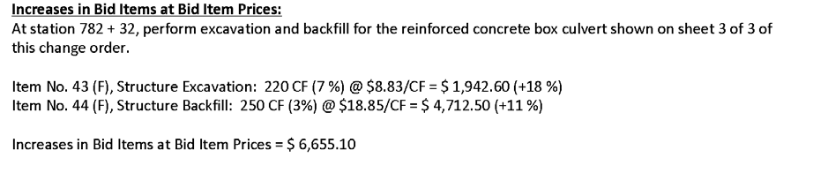
Change Orders:
Method of Payment
CM 5-306C Methods of Payment
Notes:
Trainer Notes:
Engineer’s Estimate: Are estimate
ASK Class: What are the percentages on each side
Why do you need to track this? So you will know if a contract item adjustment is warranted
Show changes in contract item quantities as estimates on a contract change order
ASK CLASS: What do the percentages represent and why aren’t they the same on both sides of the equation.
ANSWER: The first tracks the % increase or decrease to the item due to this CCO
The second tracks the % increase or decrease to the item due to all CCOs to date.

Slide 19
Change Orders:
Method of Payment
Extra work at agreed prices
  Agreed Unit Price
  Agreed Lump Sum
  Contractor must agree!
  CM 5-306C Methods of Payment
Notes:
Trainer Notes:
If there is no item: Try agreed price. Place Calc in file
ASK CLASS: Difference between agreed UNIT prices and agreed LUMP?
ASK CLASS: Difference between Agreed unit prices with Contract Item Prices.
ASK CLASS: Can you unilaterally approve an agreed price CCO!
You cannot unilaterally approve an agreed price CCO!
If you authorize the contractor to begin work before a CCO is signed, get it in writing that the Contractor agrees to the price.
Agreed Unit price allows flexibility for extra work that you can not pin down the quantity.

Slide 20
Change Orders:
Method of Payment
Agreed price documentation:
  Must perform an independent force account cost estimate:
    Performed by the agency independently of Contractor
    Supports the agreed price in the CO
    Signed and dated by Preparer
    Signed and dated by Checker
    Filed
Notes:
Trainer Notes:
ASK CLASS: what do we mean by independent?
Answer: Performed by the agency, not the contractor
It’s OK to ask the contractor to submit a cost proposal: But you must first do your own before you review the Contractor’s .
If they differ, decide if one of you over or under estimated some aspect of the work. Correct if warranted.
If you are so far apart, then you can’t agree – go force account.
File in the contract records any calculations made to determine price agreed to and shown on the CCO.
These calculations are subject to audit and must be in such a form that they clearly substantiate and justify the amount paid for extra work.

Slide 21
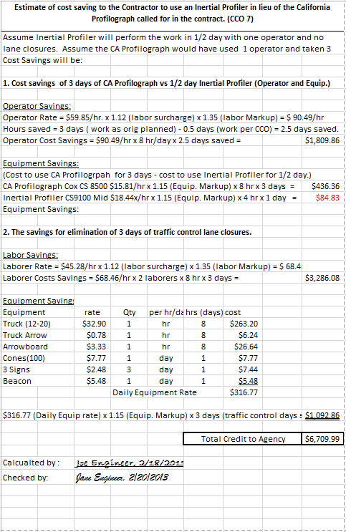
Change Orders:
Method of Payment
Agreed price
documentation:
Force Account Style Cost Estimate
(Handout Pg. 12)
Notes:
Trainer Notes:
ASK CLASS: what do we mean by independent?
Answer: Performed by the agency, not the contractor
It’s OK to ask the contractor to submit a cost proposal: But you must first do your own before you review the Contractor’s .
If they differ, decide if one of you over or under estimated some aspect of the work. Correct if warranted.
If you are so far apart, then you can’t agree – go force account.
File in the contract records any calculations made to determine price agreed to and shown on the CCO.
These calculations are subject to audit and must be in such a form that they clearly substantiate and justify the amount paid for extra work.

Slide 22
Change Orders:
Method of Payment
Extra Work at Force Account
Use when:
The work cannot be estimated within reasonable limits of accuracy
The RE and contractor are unable to agree on an agreed price
When the work is urgent/time sensitive
CM 5-306C Methods of Payment
Notes:
Trainer Notes:
Least desirable as you have less control.
ASK QUESTION: When would you do this.
Push the contactor to get his DEWRs in soon.
Agree on work daily.

Slide 23
Change Orders:
Method of Payment
If a work-character change has occurred:
Determine a correct and equitable adjustment in compensation to the bid item unit price
Last resort! – Delete the entire bid item, or the portion of it affected by the change, and pay for the entire work as extra work
CM 5-306C Methods of Payment
CTSS 4-1.05B Work-Character Changes
Notes:
Trainer Notes:
Note that an adjustment in compensation providing for increased or decreased costs due to the change in character allows the contract price to remain unchanged.

Slide 24
Change Orders:
Time Extensions/Reductions
Add contract time in a CO?
CO must affect the scheduled completion date
  contractor submits a Time Impact Analysis (TIA)
If CO work affects the controlling activity on the critical path, there may be basis for a time adjustment.
The Department grants a time extension only if the total float is absorbed and the scheduled completion date is delayed 1 or more working days.
CTSS 8-1.02D(8)(c) Ordered Changes
CM 5-306D Adjustment to Time of Completion
Notes:
Trainer Notes:
When do you adjust time
1. Write deferred if you cannot agree
2. Adjustment of time can be + days, - days, or zero adjustment.
3. If schedule complete date is not affected, then no time
4. Float available: No extra time
SHOW THE DOCUMENTATION
Whenever you can estimate an adjustment to time with reasonable accuracy, try to reach agreement with the contractor. Enter the amount of the time adjustment on the change order (including when there is no adjustment).
Regardless of the amount of time actually required to perform the changed work, the agreed adjustment becomes binding on both parties.

Slide 25
Change Orders:
Deferred Time Adjustment
Can’t determine / agree on an adjustment of time
Determine time adjustment as soon as work is completed
Unilaterally approve the supplemental CO if you still cannot agree
LAPM 16.10 Change Orders
CM 5-306D Adjustments to Time of Completion
Notes:
Trainer Notes:
ASK CLASS for examples of when time could not be determined? (by nature of the operation)
ASK CLASS: Can you unilaterally decrease contract time.
ANSWER: NO.
1. No Benefit to agency: Don’t issue
2. If there is a benefit: Can sign unilaterally

Slide 26
Change Orders:
Time Adjustment Documentation
File TIA used to support CO time adjustment.
No supporting documentation
= loss of federal funds
= number unsupported days given x LDs($)
LAPM 16.10 Change Orders
CM 5-306D Adjustments to Time of Completion
Notes:
Trainer Notes:
File Time adjustment back up
File with the contract records the calculations and other data used to determine adjustments to time.
Must have supporting documentation.
Time impact analysis
Dates if possible
Collaborations between the WSWD, the schedule and the CCO.
You will lose federal funding if an auditor finds that you extended contract time without proper justification or documentation.

Slide 27
Change Orders:
Resources
CT Construction Manual!
Chapter 5 Contract Administration
Section 3 Change Orders
Change Order Standard Clauses:
https://dot.ca.gov/programs/construction/change-order-information/change-order-standard-clauses
Examples of Change Orders:
https://dot.ca.gov/programs/construction/change-order-information/change-order-examples
Notes:
Trainer Notes:
Highly recommended:
1.Use standard clauses in CM Manual
2.examples of standard clauses for specific situations found in various types of contract change orders
3. examples of typical CCOs and commonly written CCOs.

Slide 28
Change Orders:
Sample Clauses
Adjustment for Increase in Quantities in Excess of 25 Percent of the Quantities Shown on the Bid Item List
Standard Clause:
Payment adjustment in accordance with Section 9-1.06B, “Increases of More Than 25 Percent,” of the Standard Specifications:
The following adjustment(s) will be made for units of work in excess of 125 percent of the quantities shown on the bid item list:
[List the bid(s), unit adjustments, quantities, and total item adjustment(s).]
Notes:
Trainer Notes:
More Clauses Examples
Point out how situation 2 differs from situation 1 in the previous slide.

Slide 29
Change Orders:
Sample Clauses
Extra Work or Payment Adjustment at Agreed Unit Price
Standard Clause:
For this work, the contractor shall receive and accept $ __ per [unit] of [pipe, fence, among other items]. This sum constitutes full and complete compensation for furnishing all labor, material, equipment, tools, and incidentals including all markups by reason of this change.
Notes:
Trainer Notes:
More examples
These are examples of standard CCO clauses that are available. Just let students read these . Don’t need to spend too much time on them.

Slide 30
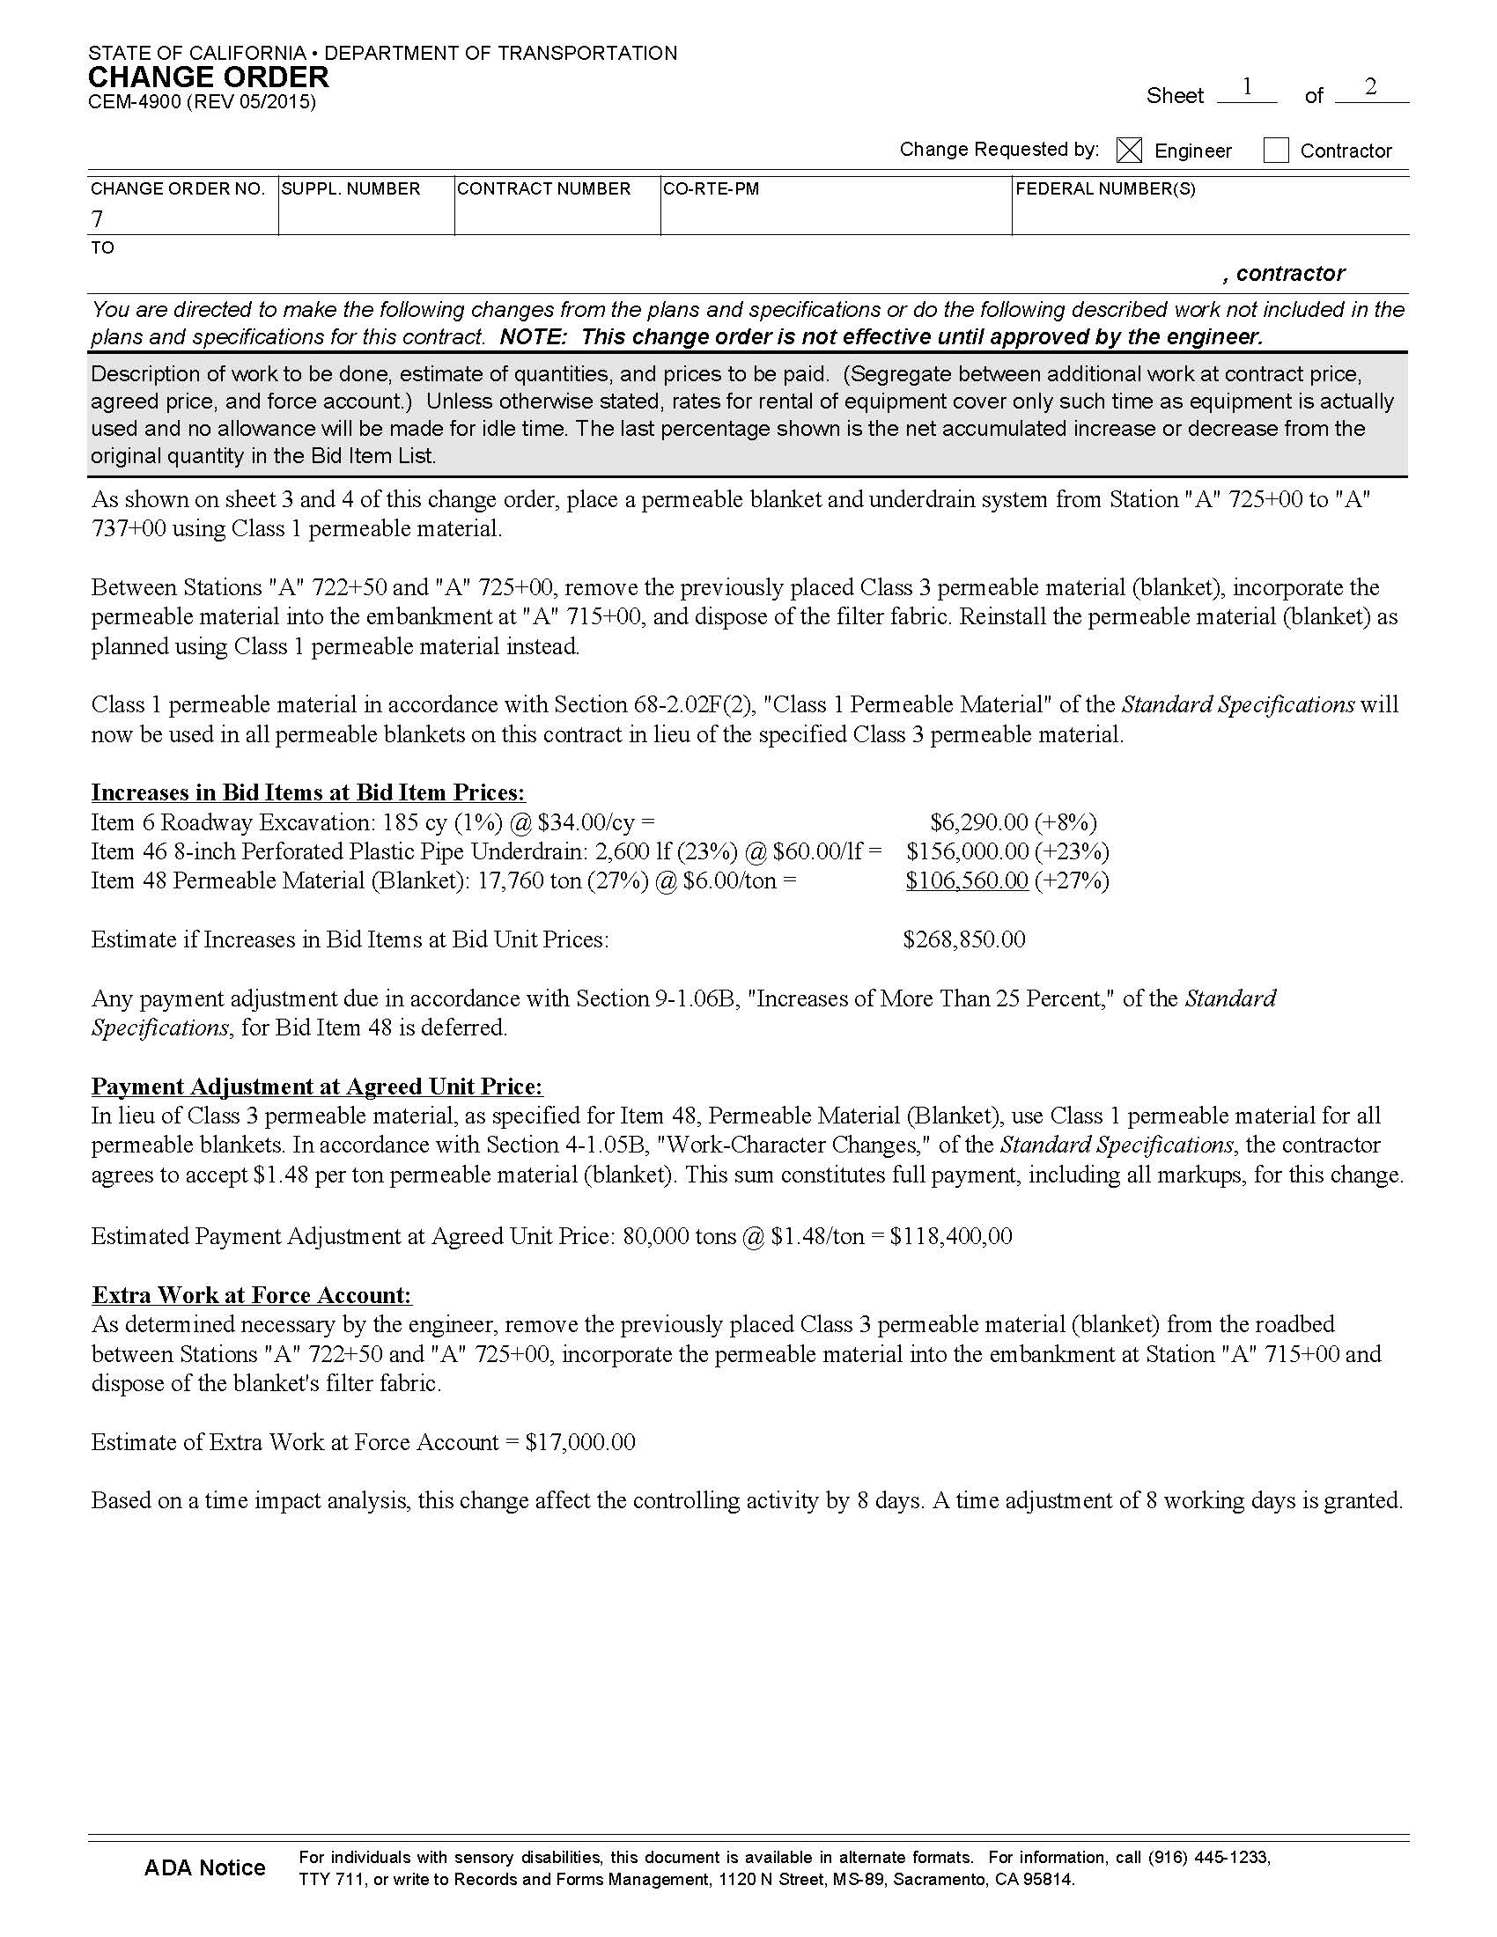
Change Orders:
Examples
CM Example
Work-Character Change
Item Increase, Payment Adjustment, Extra Work at Force Account
(Handout Pg. 13)
Notes:
Trainer Notes:
Have students go over had out to read this
Go over each example
Highly recommended: See standard clauses in CM Manual
See example CCO’s
Have students go to the handout so they can read this.
Re-emphasize the % shown and what they represent.
Point out:
clause to defer adjustment for the items over-running 25%
clause to defer any adjustment for item under-running 25%
Extra Work Agreed Unit Price has been established for Type F Dike because there is no item for Type F
There should be an agency prepared cost estimate on file supporting this agreed unit price and another one for the agreed Lump Sum price for installation of 99 drains.
That for the increase in item work, no specifications need be called out, as the contract already provides for that.
But for the Lump Sum work, the CCO needs to include specifications.

Slide 31
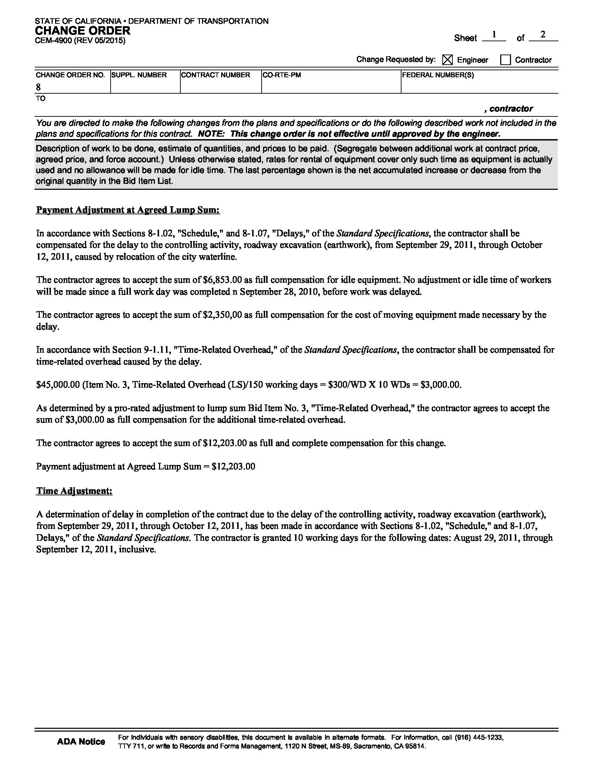
Change Orders:
Examples
CM Example
Critical Delay
Payment Adjustment at Agreed Lump Sum and Time Adjustment
(Handout Pg. 14)
Notes:
Trainer Notes:
Have students go over had out to read this
Go over each example
Highly recommended: See standard clauses in CM Manual
See example CCO’s
Have students go to the handout so they can read this.
Re-emphasize the % shown and what they represent.
Point out:
clause to defer adjustment for the items over-running 25%
clause to defer any adjustment for item under-running 25%
Extra Work Agreed Unit Price has been established for Type F Dike because there is no item for Type F
There should be an agency prepared cost estimate on file supporting this agreed unit price and another one for the agreed Lump Sum price for installation of 99 drains.
That for the increase in item work, no specifications need be called out, as the contract already provides for that.
But for the Lump Sum work, the CCO needs to include specifications.

Slide 32
Change Orders:
Memorandum
What is the CO Memorandum?
Internal document
Explains the scope and reasons for the change
Provides justification for the work
Supports reasonableness of the compensation
    Money
    Time
CM 5-307 Change Order Memorandum
Notes:
Trainer Notes:
AKA Letter to File at some agencies.
Discuss memo
While the CCO answers the What and How questions, the memorandum generally answers the question, “Why?”
The memorandum must be sufficiently complete to enable a person unfamiliar with the details of the project to review the change order and understand the justification for the work, the reasonableness of the compensation, and the time adjustment provisions.
Do not send the memorandum to the contractor

Slide 33
Change Orders:
Memorandum
Include:
Summary line or two of what the change order provides
Why the change is needed
CM 5-307 Change Order Memorandum
Notes:
Trainer Notes:
Go over Bullets
WHAT: “The What” should be brief. Don’t need to repeat all the detail shown on the CCO. Try to reduce to CCO to a line or two.
WHY: When another unit, agency or person requests a change, the correspondence requesting the change should also justify the need for the change. Attach supporting letters to the memorandum.
Field conditions differed from plans.
Requested by traffic safety engineer because….

Slide 34
Change Orders:
Memorandum
Include:
  Why the particular method of payment was chosen.
  State the method used in making the cost analysis
  Include the cost analysis in the files
  CM 5-307 Change Order Memorandum
Notes:
Trainer Notes:
Examples of reasons why method was chosen:
Not contract items exist to cover the work. (so used Agreed Price)
Could not come to agree price with the contractor. (so used FA)
Quantity of work to be performed will not be know until the work is begun (so used FA)
Method used in making cost analysis (most common answer is force account method)

Slide 35
Change Orders:
Memorandum
Include:
Justification for contract time adjustment:
  State controlling operation during the delay period
  Indicate the specific calendar or working days represented by the time extension (if work done)
  Note that TIA is on file
CTSS 8-1.07B
Green Book 6-4.2 Extensions of Time
Notes:
Trainer Notes:
Why time

Slide 36
Change Orders:
Memorandum
Include:
  Who requested the change
  Names and dates of concurrences obtained
  Explanation of any concurrences not obtained
    CM 5-307 Change Order Memorandum
Notes:
Trainer Notes:
Memo: State concurrence
Who requested the change: the contractor, another department another agency (if yes, provide names and titles, and explain why)
State concurrence: State the extent of coordination and concurrence.
ASK CLASS: Give me some example of who you might need concurrence from?
ANSWER: Traffic Dept, RW Engineer, Environmental liaison,
Concurrences Not Obtained: If agreement with any unit, agency or person cannot be obtained, then indicate specifically what was said and why it should or should not influence a decision for approval.
State the extent of coordination and concurrence: If agreement with any unit, agency or person cannot be obtained, then indicate specifically what was said and why it should or should not influence a decision for approval.
If prior approval of the change order has been obtained: State the name of the person who granted prior approval and the date.

Slide 37
Change Orders:
Memorandum
If …
  Work character change results from CO, explain why
  CO was unilaterally approved, explain why
  CM 5-307 Change Order Memorandum
Notes:
Trainer Notes:
Read Bullets
To substantiate why any additional compensation is due for work character change, you may need to provide a summary of events leading up to the change.
Unilateral approval is when only one side approves it and processes it.
CCO was unilaterally approved, explain why the contractor will not sign it or why the contractor’s signature is not required.
At the beginning of the project, the resident engineer should receive the federal detail estimate with an estimate for each category of funds and the applicable limits of federal eligibility. If you do not receive this detail estimate, contact the PM.
Non-participating = not eligible for federal reimbursement (see next 2 slides)

Slide 38
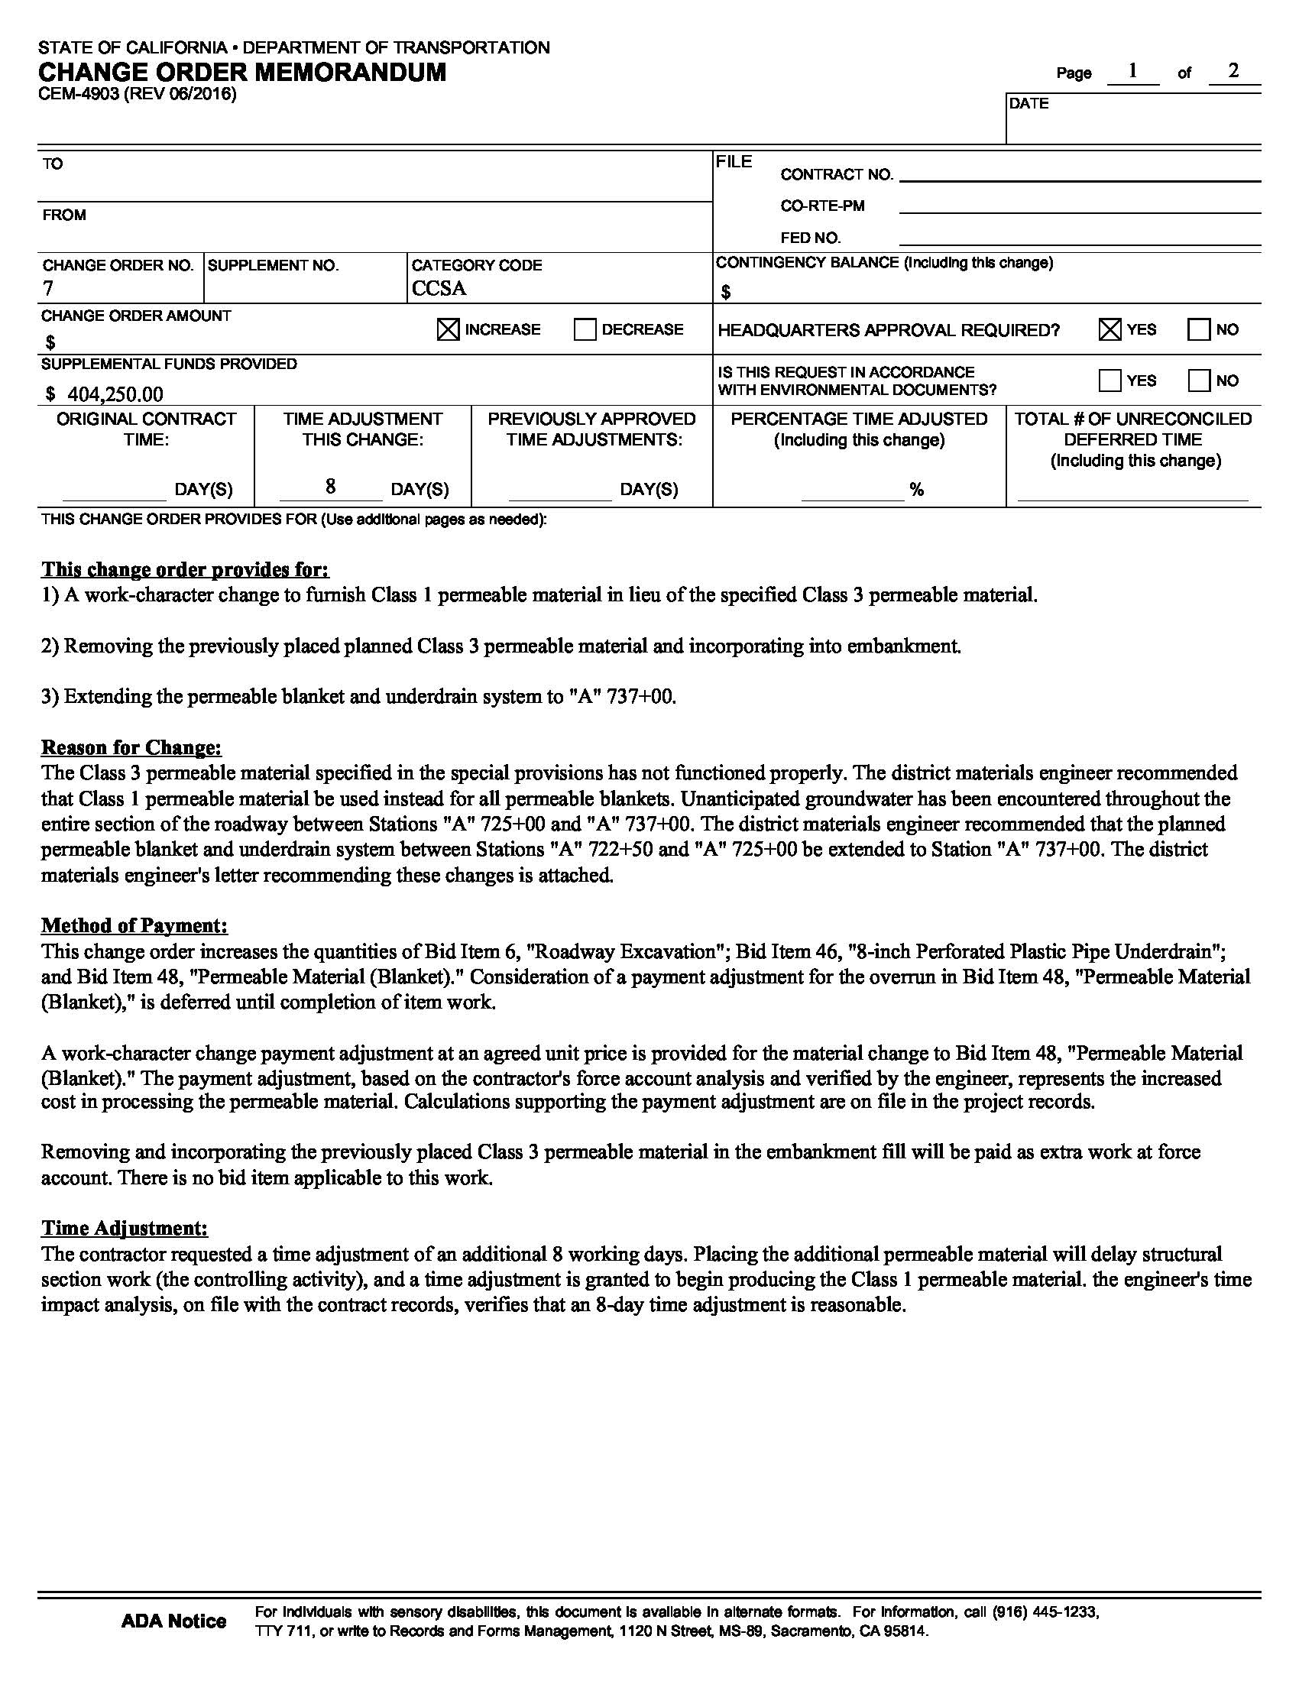
Change Orders:
Memorandum
CM Example
Work-Character Change
(Handout Pg. 15)
Notes:
Trainer Notes:
GO over Memo
Each item 1 through 4 explain “why” the action is being done and discuss the method of payment.
Provide explanation why “dike accidently omitted from the project” / increase in contract item
“Not included in project plans,” /”no applicable bid item”
Provides “why” the dike was deleted/ “decrease in quantity”
“necessary to transfer dike from ditch” – explains how it is in the scope of the job/ “no applicable bid item”
Note concurrence was obtained and form whom.

Slide 39
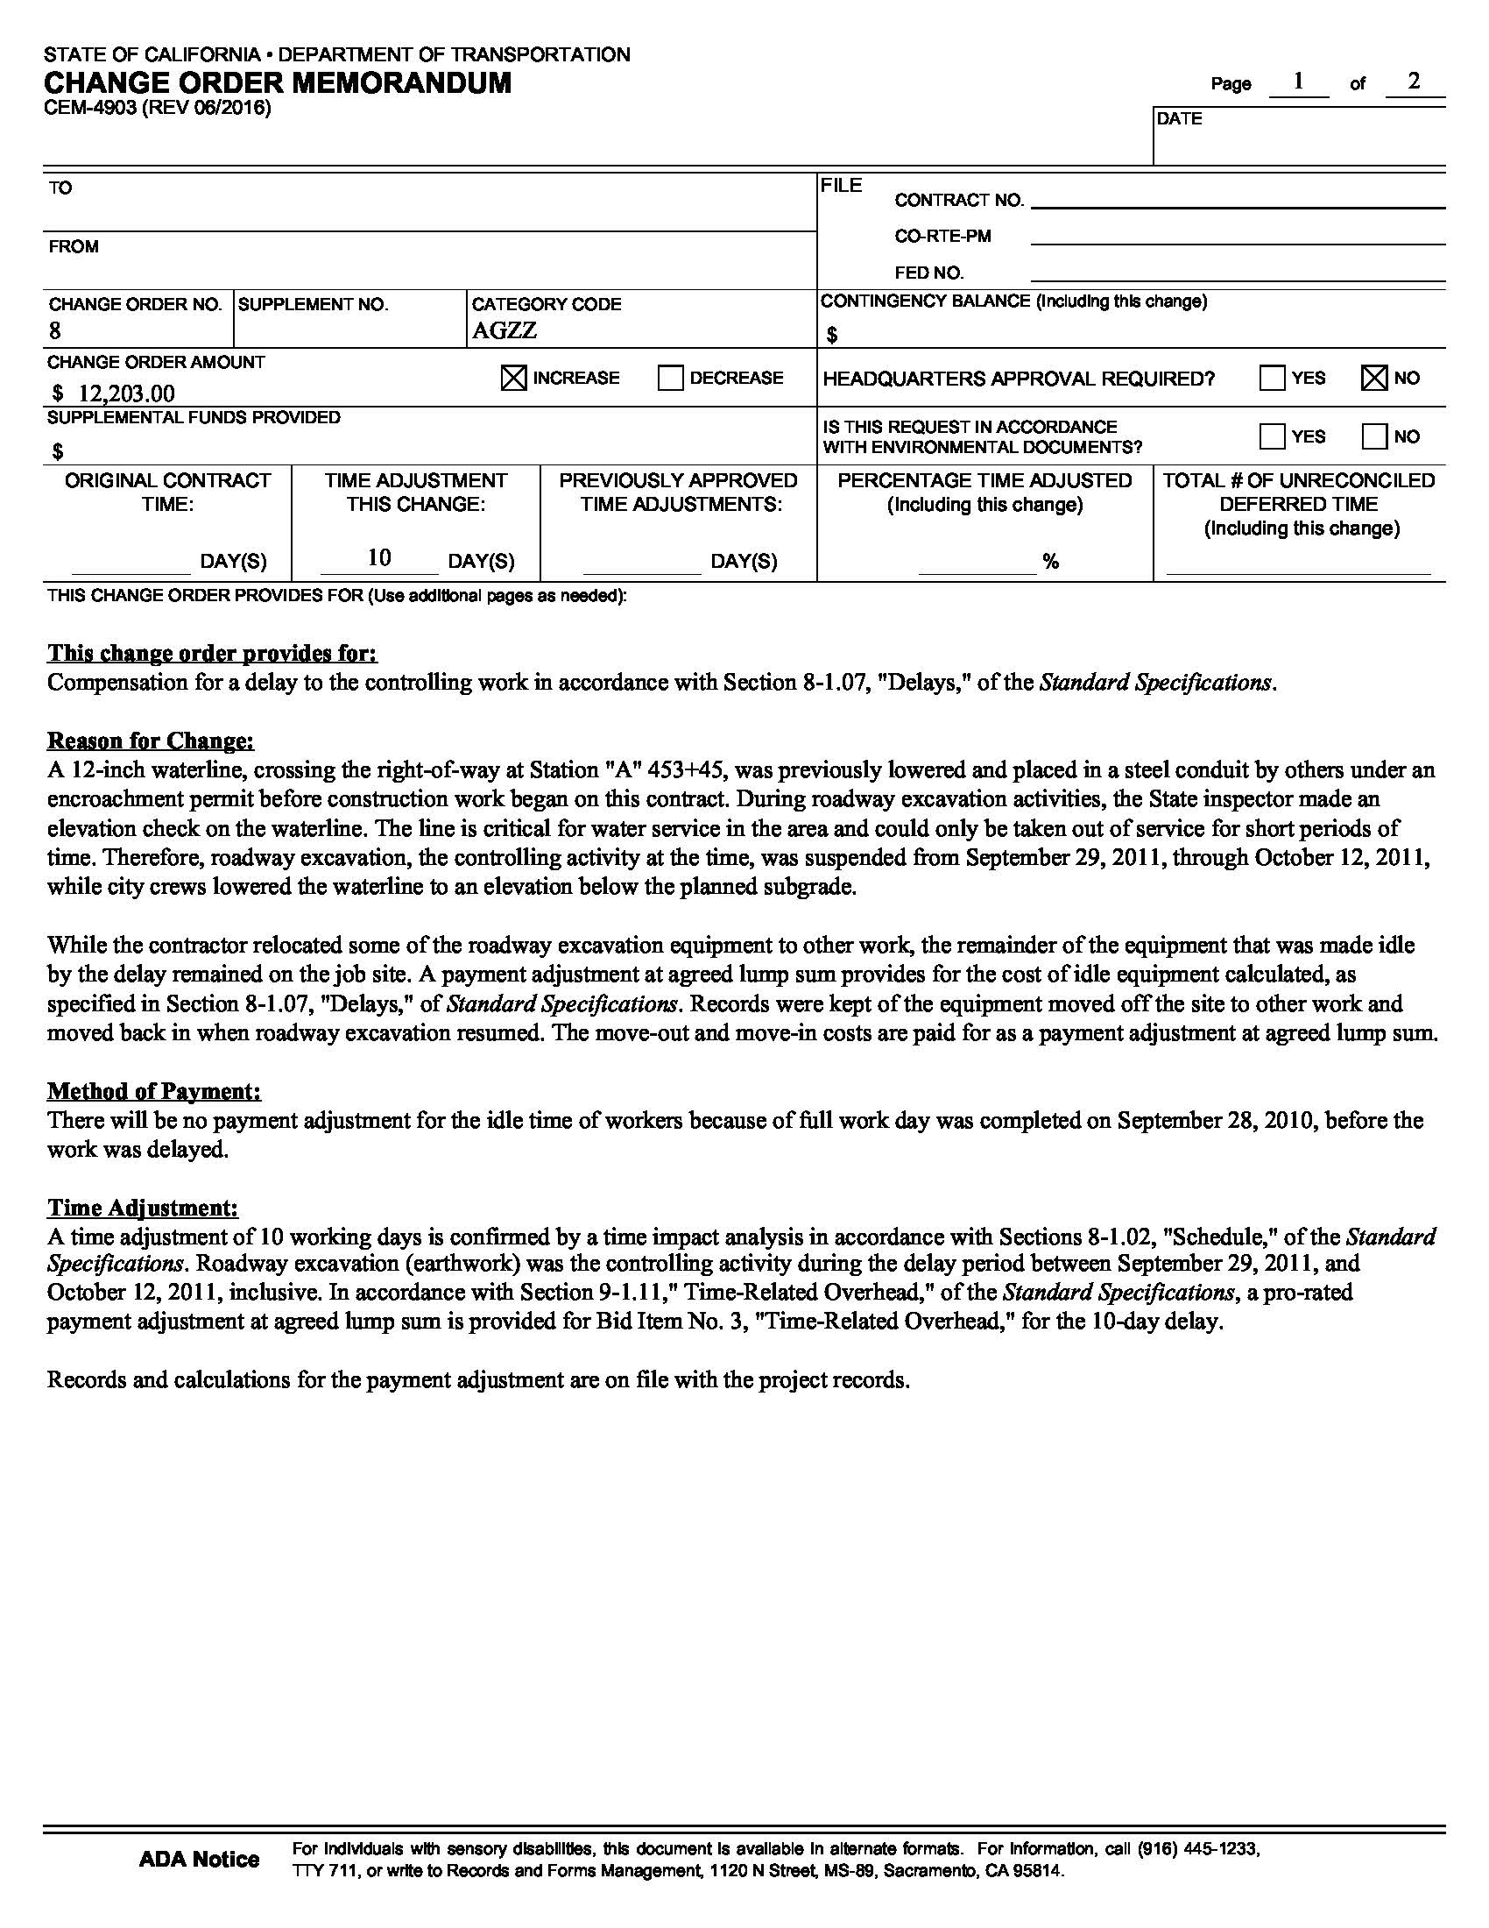
Change Orders:
Memorandum
CM Example
Critical Delay
(Handout Pg. 16)
Notes:
Trainer Notes:
GO over Memo
Each item 1 through 4 explain “why” the action is being done and discuss the method of payment.
Provide explanation why “dike accidently omitted from the project” / increase in contract item
“Not included in project plans,” /”no applicable bid item”
Provides “why” the dike was deleted/ “decrease in quantity”
“necessary to transfer dike from ditch” – explains how it is in the scope of the job/ “no applicable bid item”
Note concurrence was obtained and form whom.

Slide 40
Change Orders:
Federal Funding Participation
Indicate on the Memorandum:
  Federal fund participation,
  Participation in part, or
  Nonparticipation
Don’t use nonparticipation to
circumvent federal requirements.
LAPM 16.10 Change Orders
Notes:
Trainer Notes:
In general, most changes are participating provided they are necessary to complete the project as originally contemplated at the time the plans and specifications were approved.
Third bullet: Big issue with utility companies (AT&T)
Cant waive Buy America by saying you are paying for the steel with local money. Could jeopardize all your federal project funding

Slide 41
Change Orders:
Nonparticipating Items
  FHWA List of Frequently Encountered Non-Federal Participating Items
  (Handout Pgs. 17-18)
LAPM 16.10 Change Orders
Notes:
Trainer Notes:
Read bullets
Cannot bill to DLA
Where are the true project limits defined? The E76
Maintenance work: regular trash pickup, regular street sweeping (street sweeping by contractor due to construction OK)

Slide 42

Change Orders:
Payment
  Payment cannot be made until Change Order is fully executed!
LAPM 16.10 Change Orders
Notes:
Trainer Notes:
Read bullets
Cannot bill to DLA
Where are the true project limits defined? The E76
Maintenance work: regular trash pickup, regular street sweeping (street sweeping by contractor due to construction OK)

Slide 43

Change Orders:
Poll
Notes:
Trainer Notes:

Slide 44
Change Orders:
Poll
True or False
CO payment method order of preference:
Contract items at contract unit prices
Contract items at contract prices with an adjustment in compensation
Extra work at agreed unit price or lump sum
Extra work at force account
Notes:
Trainer Notes:

Slide 45
Change Orders:
Poll
True or False
CCO payment method order of preference:
Contract items at contract unit prices
Contract items at contract prices with an adjustment in compensation
Extra work at agreed unit price or lump sum
Extra work at force account
True
Notes:
Trainer Notes:

Slide 46
Change Orders:
Poll
Notes:
Trainer Notes:

Slide 47
Change Orders:
Quiz
Which of the following is not a reason to write a change order:
To change contract plans/specifications
To describe the extra work and method of payment for extra work
To make adjustments in compensation
To implement the contractor’s cost reduction proposal to eliminate the project environmental documents
Notes:
Trainer Notes:

Slide 48
Change Orders:
Quiz
Which of the following is not a reason to write a change order:
To change contract plans/specifications
To describe the extra work and method of payment for extra work
To make adjustments in compensation
To implement the contractor’s cost reduction proposal to eliminate the project environmental documents
Notes:
Trainer Notes:

Slide 49
Change Orders:
Quiz
Notes:
Trainer Notes:

Slide 50
Change Orders:
Quiz
True or False
Only use the extra work at force account method of payment under the following conditions:
When the work cannot be estimated within reasonable limits of accuracy
When the resident engineer and the contractor are unable to agree on a unit or lump sum price for the work
When the work is urgent/time sensitive and no time to negotiate
Notes:
Trainer Notes:
If you do FA, make sure you agree on the forces every day in writing.

Slide 51
Change Orders:
Quiz
True
Only use the extra work at force account method of payment under the following conditions:
When the work cannot be estimated within reasonable limits of accuracy
When the resident engineer and the contractor are unable to agree on a unit or lump sum price for the work
When the work is urgent/time sensitive and no time to negotiate
Notes:
Trainer Notes:
If you do FA, make sure you agree on the forces every day in writing.

Slide 52
Change Order
Exercise
Notes:
Trainer Notes:

Slide 53
Tab 9: Change Order Exercise
The construction contract was awarded to ABC Contractors Inc. The contract plans calls for installing 50 linear feet of 24” Reinforced Concrete Pipe (RCP) across the road at Station 14+50. After contract work had begun, ABC Contractors Inc., during excavation for the 24” RCP, discovered that a sewer line that was to be below the 24” RCP, was shallower than shown on the plans. This occurred on February 1, 2011. Because the sewer line is gravity flow, the sewer line could not be relocated. After discussions with the designer, it was decided to replace the 24” RCP with 2 - 18” RCPs and raise the flowline by six inches.
The contractor’s estimated cost for start of excavation for the 24” RCP and standby time was $500. Your Independent Cost Estimate has verified this cost. You and the contractor have both agreed to defer any time adjustment. No adjustment to the bid items are necessary.
ITEM# | DESCRIPTION | QUANTITY | UNIT PRICE
16 | 18” RCP | 100 linear feet | $100.00/LF
18 | 24” RCP | 50 linear feet | $200.00/LF
Each group must prepare:
A change order and memorandum
Each group will have 20 minutes to complete this exercise.
Links to the Change order (CEM-4900) and memorandum (CEM-4903) forms are below:
https://dot.ca.gov/programs/construction/forms

Slide 54
Change Order Exercise:
24”
18”
18”
C L
Sta. 14 + 50
As Planned:
Sta. 14+50
As Changed:

